Slide 1
Design Process Portfolio
Danielle Rowe
Interaction Design 1
Spring 2021

Slide 2
Week 02
4 Personas
Brainstorm List
5 Project Ideas

Slide 3
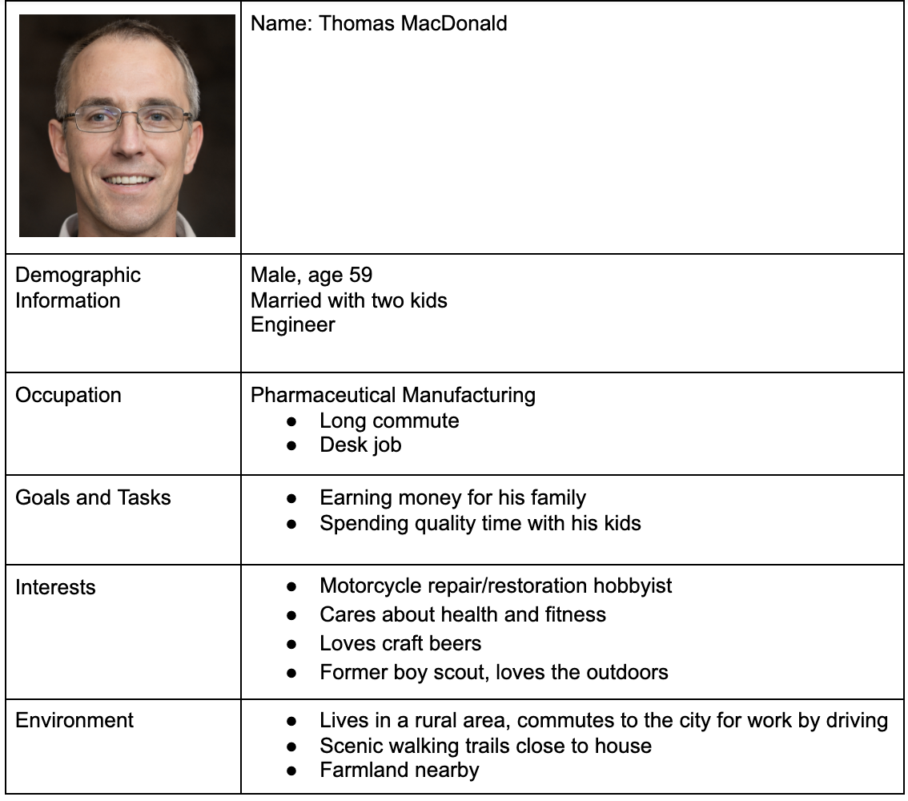
Personas are based on people I know in real life
All images are from thispersondoesnotexist.com - not real images of the people
Kept details broad, wide range of interests

Slide 4
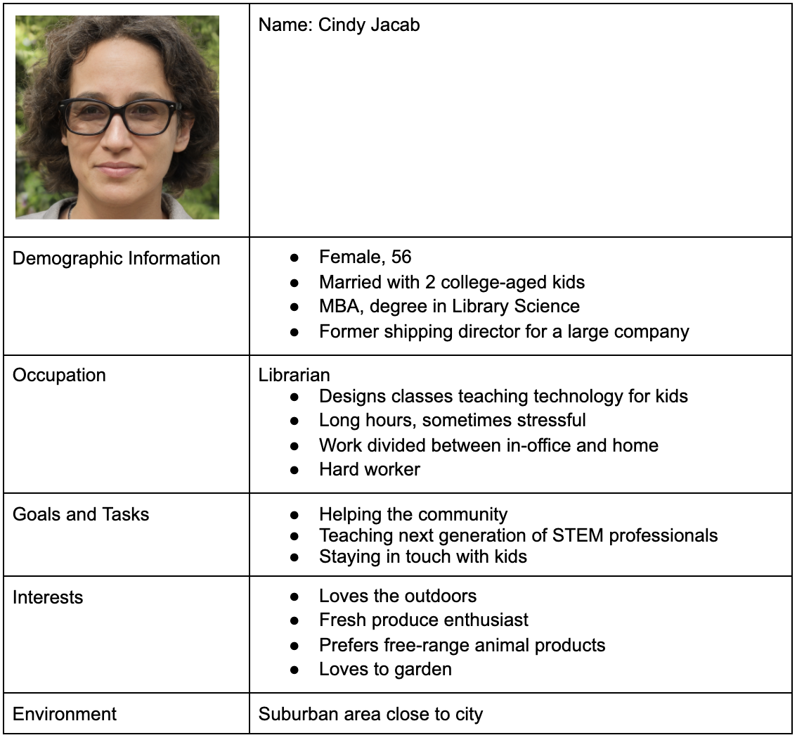
Personas are based on people I know in real life
All images are from thispersondoesnotexist.com - not real images of the people
Kept details broad, wide range of interests

Slide 5
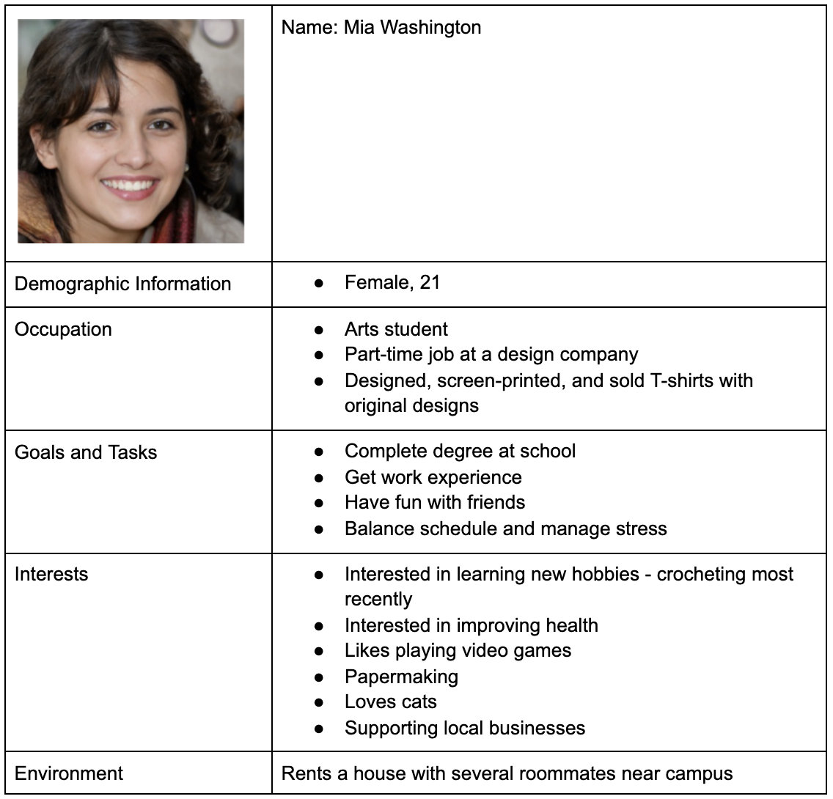
Personas are based on people I know in real life
All images are from thispersondoesnotexist.com - not real images of the people
Kept details broad, wide range of interests

Slide 6
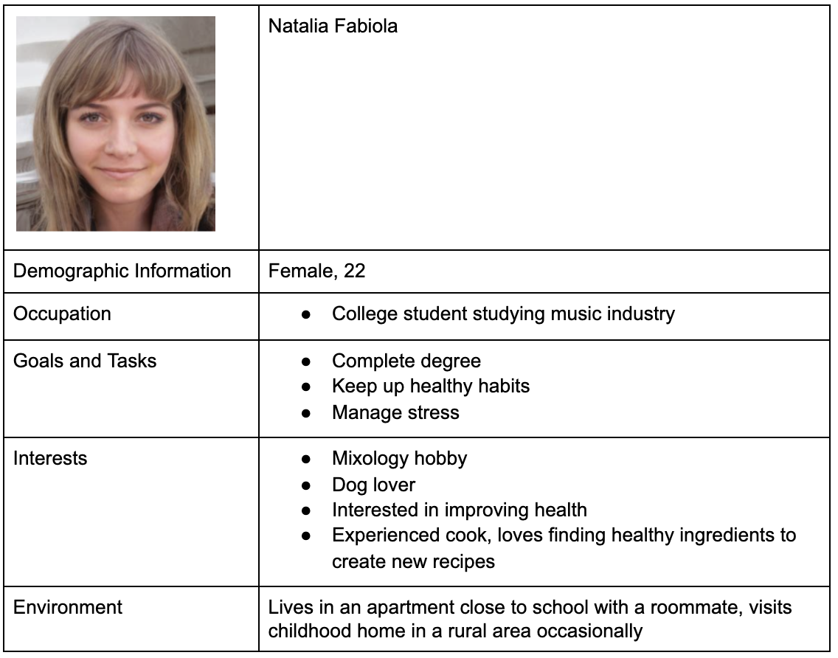
Personas are based on people I know in real life
All images are from thispersondoesnotexist.com - not real images of the people
Kept details broad, wide range of interests

Slide 7
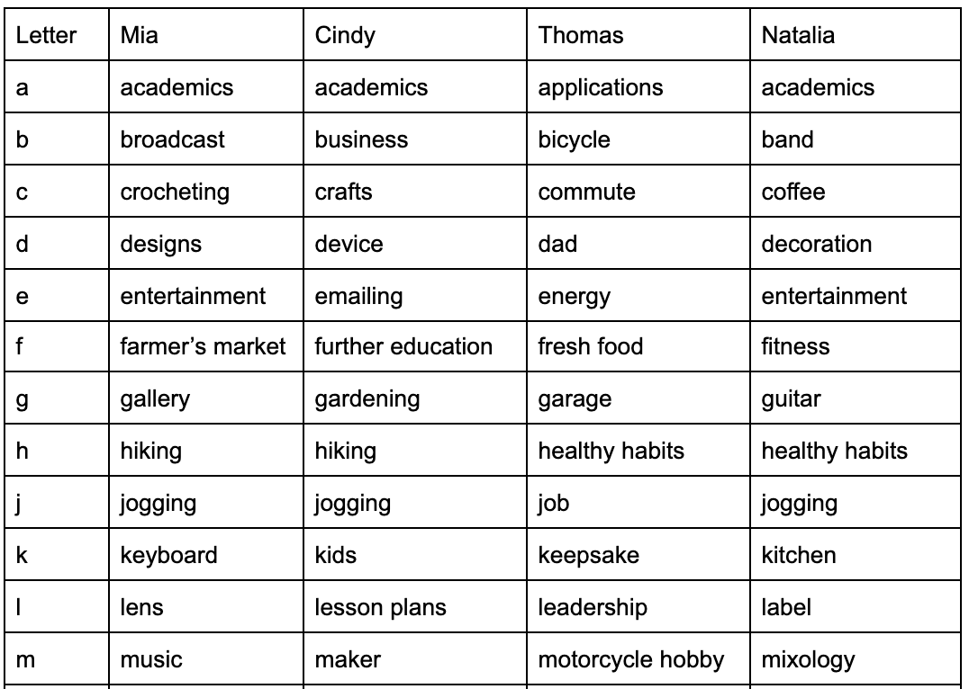
First half of the Brainstorm List
(A-M)

Slide 8
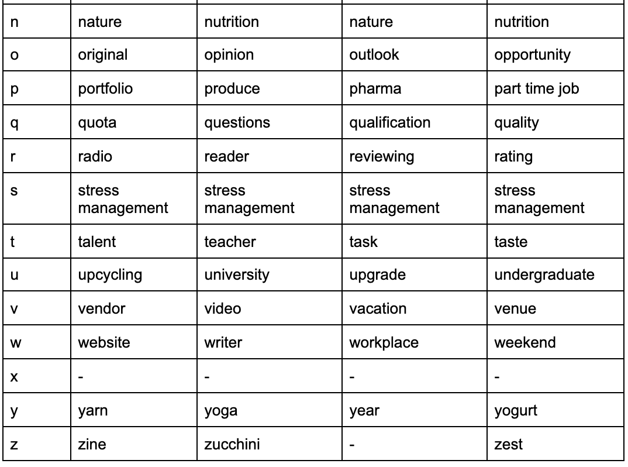
Second half of the Brainstorm List (N-Z)

Slide 9
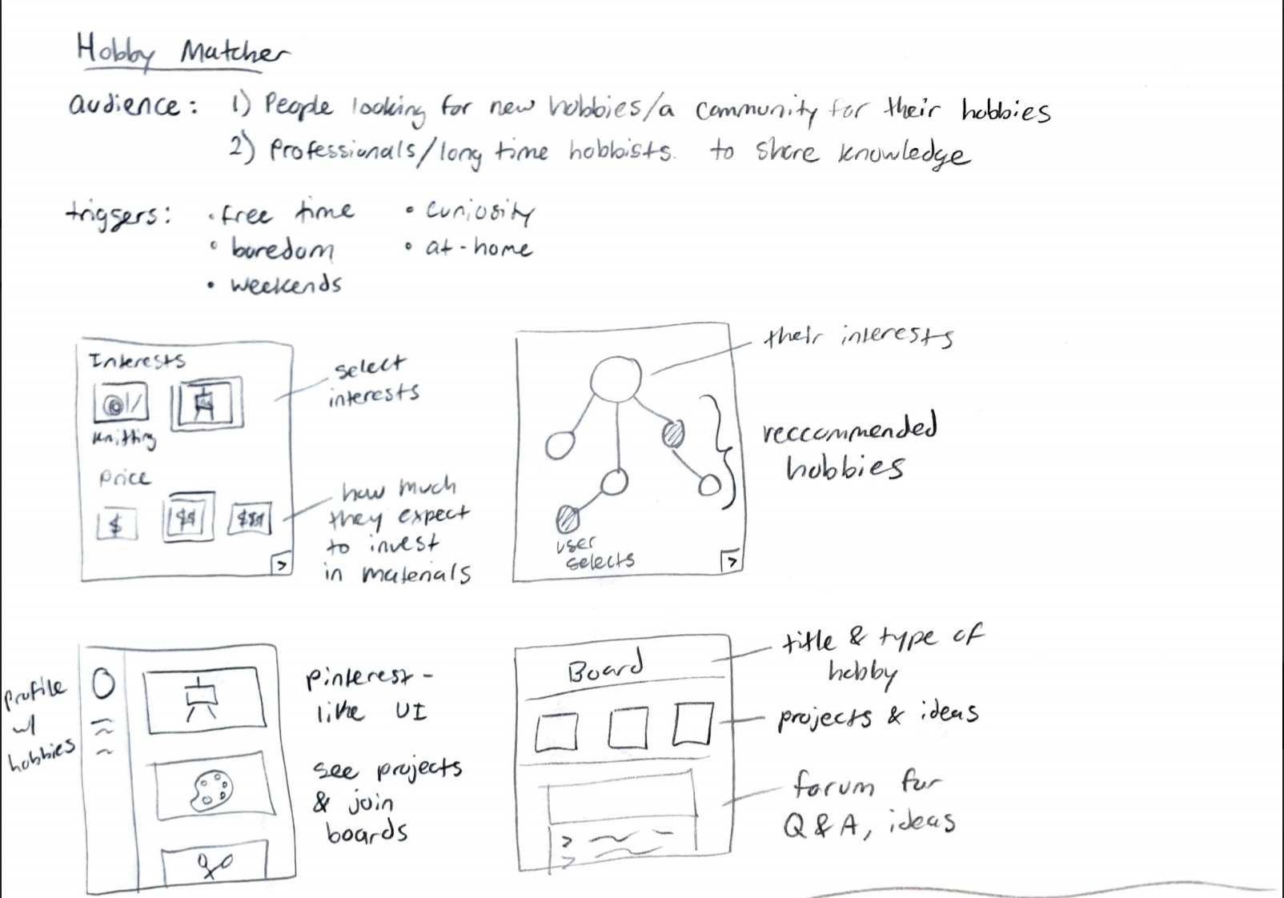
Idea #1

Slide 10
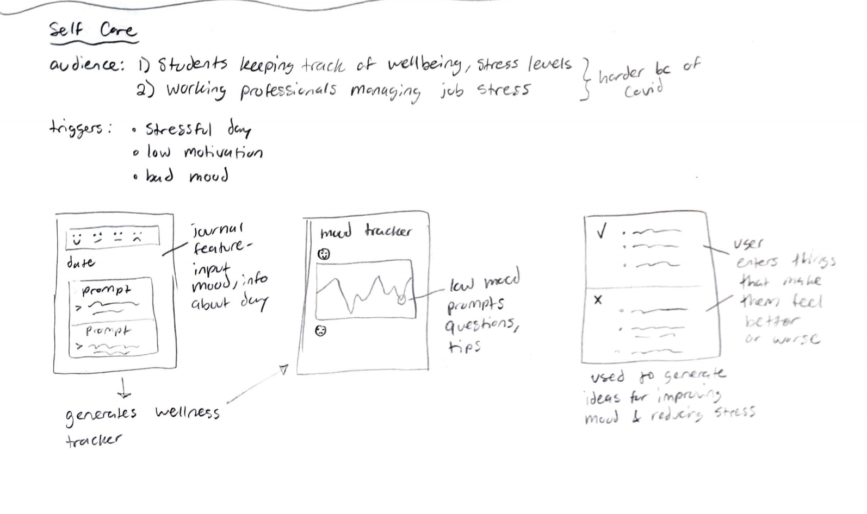
Idea #2

Slide 11
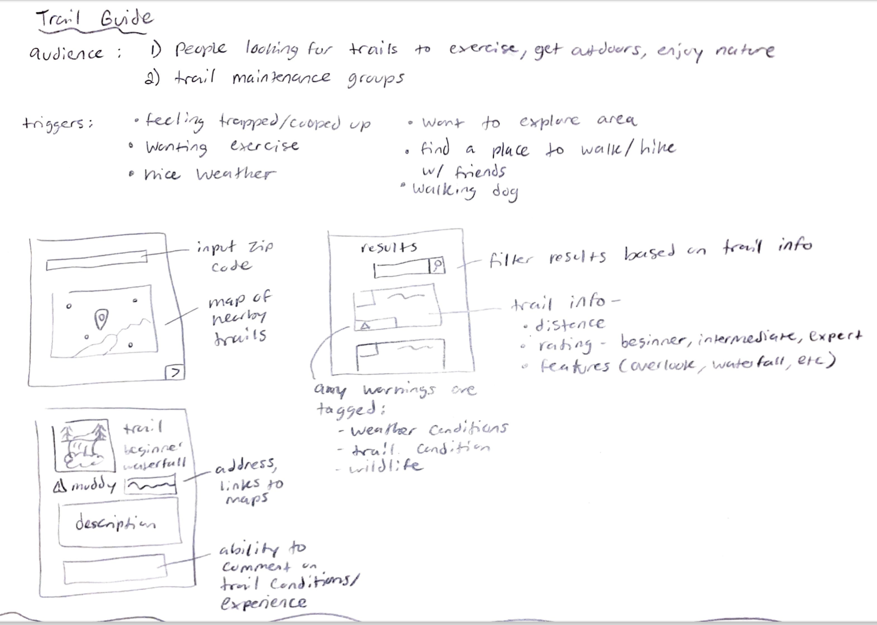
Idea #3

Slide 12
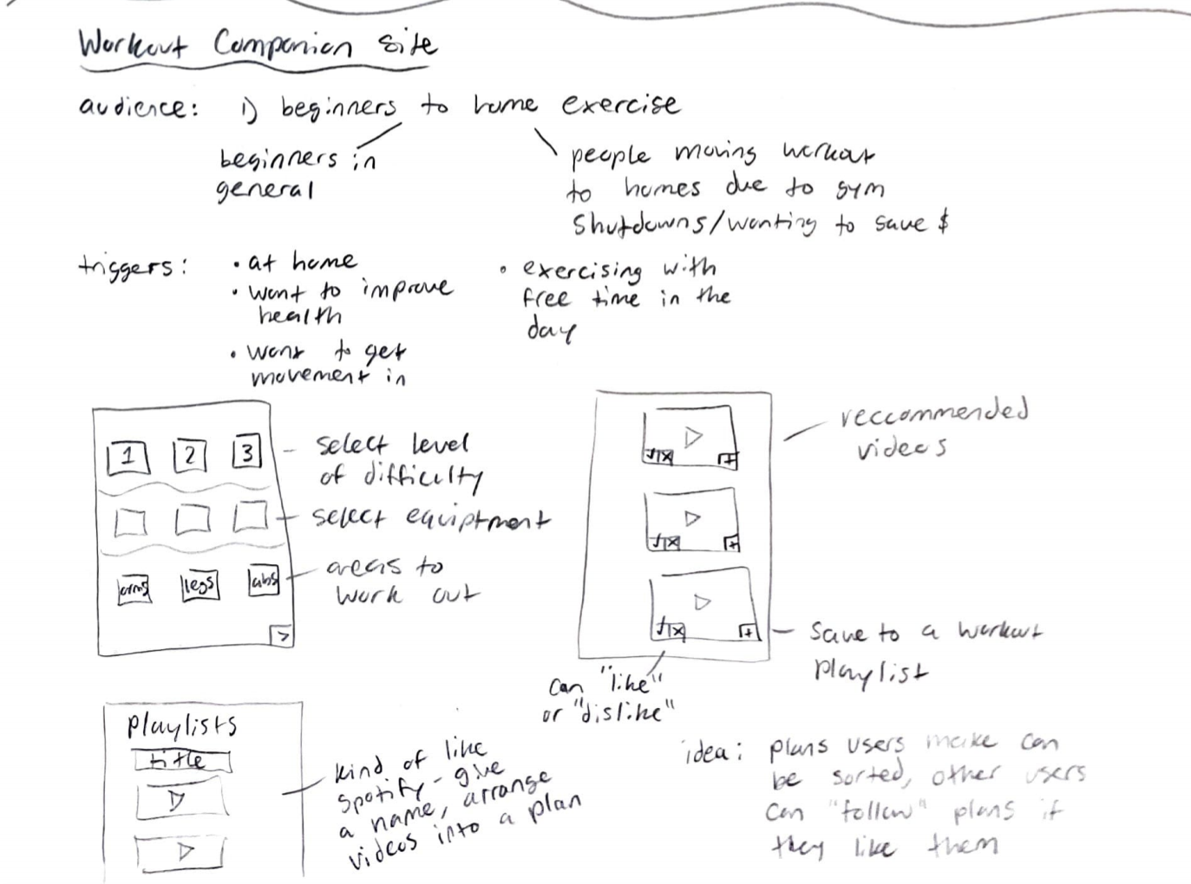
Idea #4

Slide 13
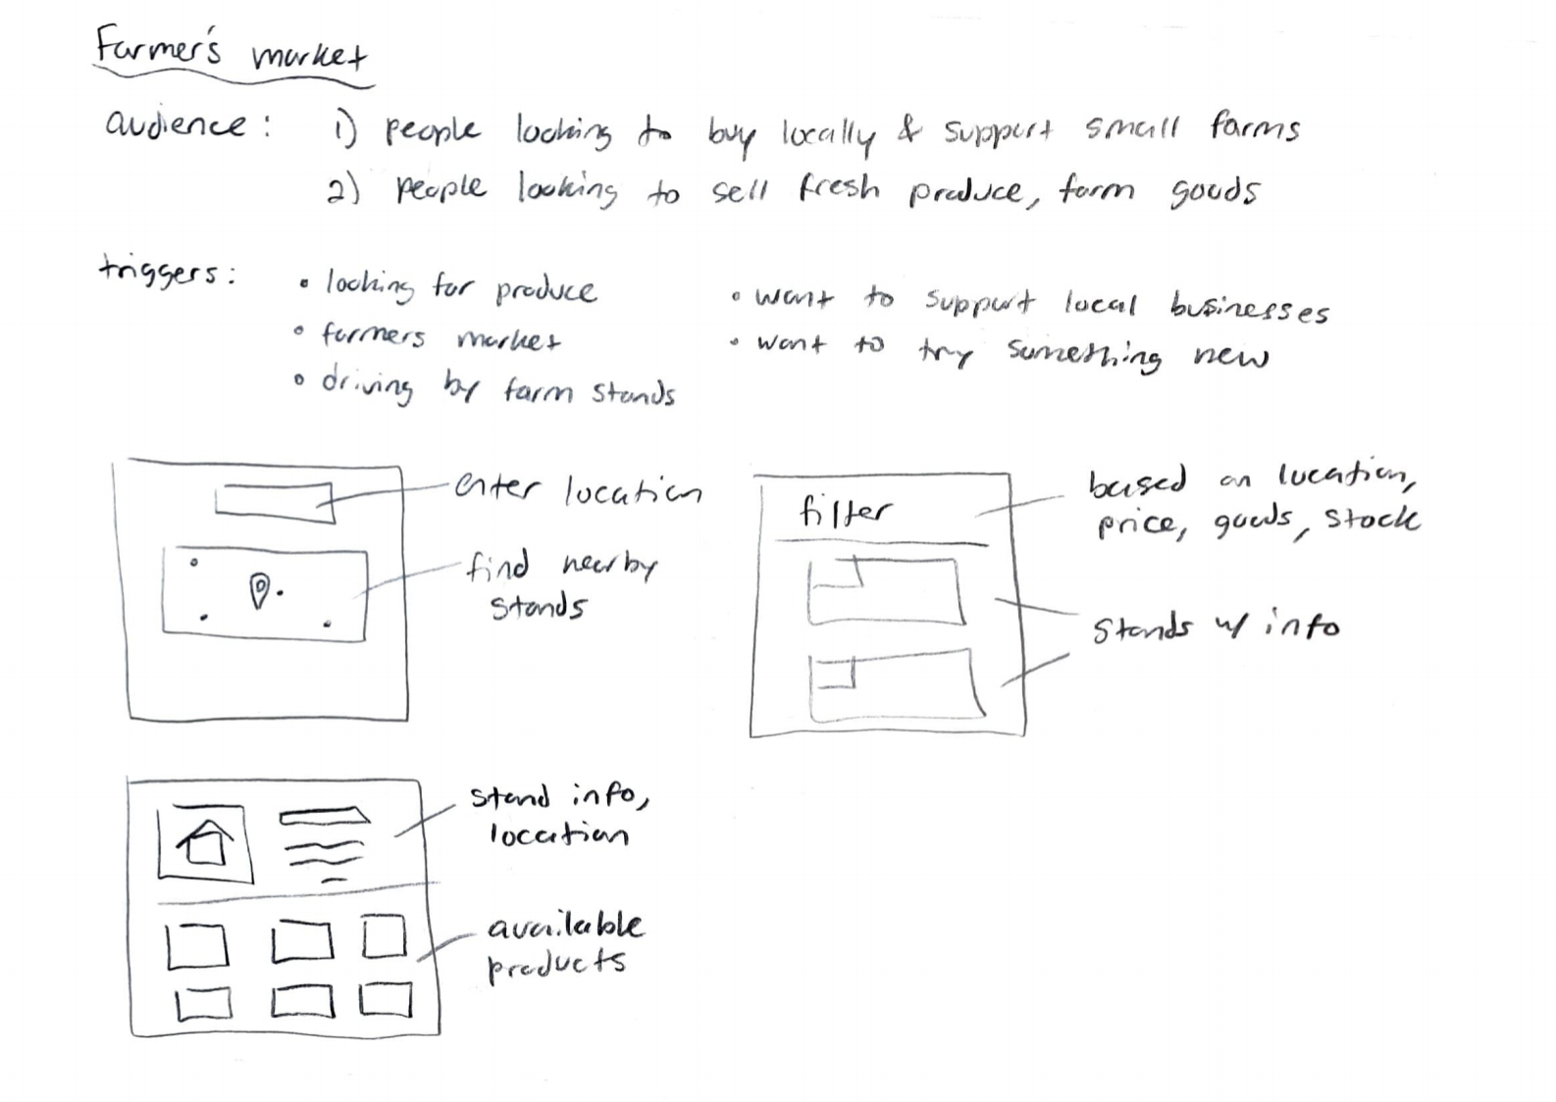
Idea #5 - Selected

Slide 14
Week 03
Interview Script

Slide 15
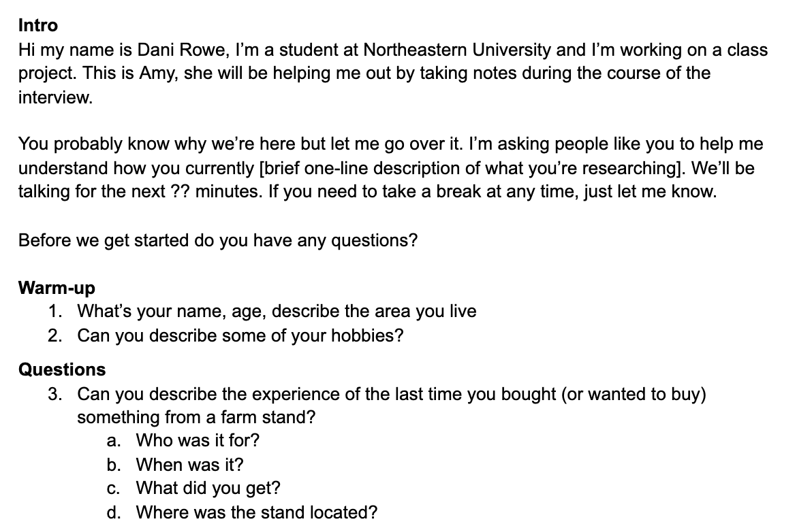

Slide 16
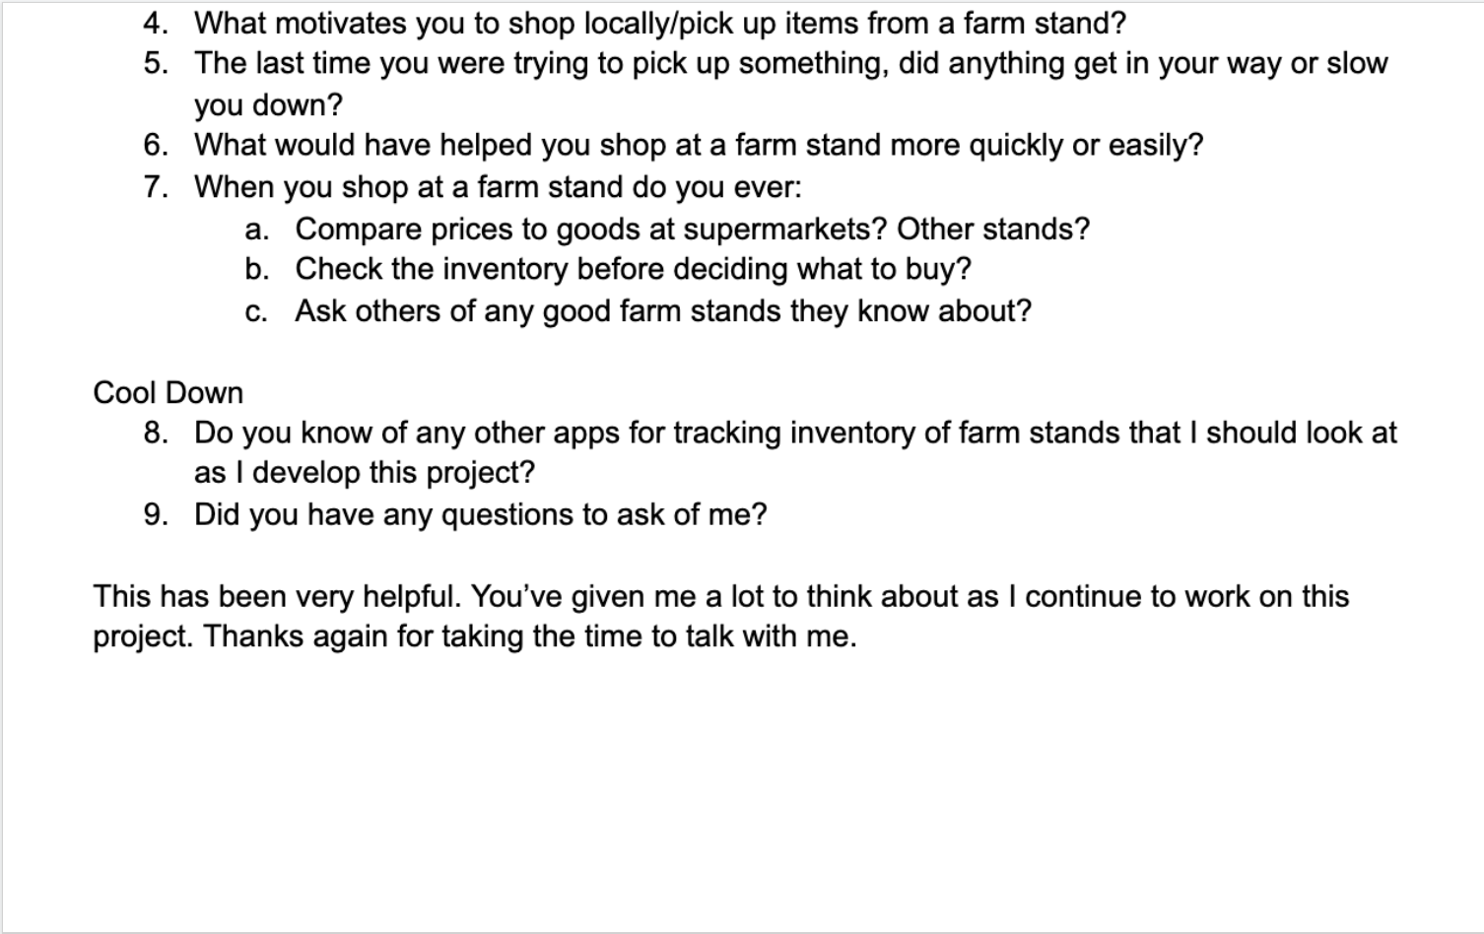

Slide 17
Week 04
Interview Findings
Revised Personas

Slide 18
Interview Results
Danielle Rowe
Interaction Design 1
Spring 2021

Slide 19
Overview
Background and purpose
Methodology
Participants
Findings
Conclusions

Slide 20
Background & Purpose
Idea: to create a website that displays local farm stands and their goods based on price, location, and inventory.
Used by people who want to shop locally, buy fresh food, and support small businesses.
Also used by small businesses and farms to advertise their goods and attract customers.
Questions:
When and why do people choose to shop from small businesses or local farmers?
What do they enjoy and not enjoy about the experience?
What would make the experience easier or more convenient?

Slide 21
Background & Purpose
Why interview?
Not relying on assumptions, getting information directly from consumers of local goods
Learn more about other people’s experiences
Find unique or shared pain points

Slide 22
Interview Methodology
Interview details
Three interviews total
Conducted by myself with classmate Amy Deng as a notetaker
Two remote over Zoom, one face-to-face at home
Criteria to select participants
Availability
Location - rural vs city
How often they shop locally
If they are interested in supporting small businesses
Type of interview
Semi-structured

Slide 23
Participants
Participant 1 (P1)
Age: 21, Female
Lives in a more urban area for school, rural hometown is close by
Student - Art and Design
Participant 2 (P2)
Age: 55, Female
Lives in a rural area
Librarian
Participant 3 (P3)
Age: 22, Female
Lives in a city
Student - Music Industry

Slide 24
Findings
Participants did not mind paying slightly more for locally grown produce
P1: “It’s fresh, it's here, it's the farmer’s”
P2: “To support small businesses especially during these times – without farmers there’s no food so it’s important they get the money they need for their products”
P2: “Price isn’t too big a factor... it has to be way out of line pricewise for me to not support a local farmer”
P3: “There aren’t as many pesticides, it’s usually organic… tastes better”
When visiting farmer’s markets, most participants were there for the experience. When visiting a specific stand, they were there for food staples
P1 visits markets with friends casually for fun, picks up new or unique products. “I listen to my stomach.”

Slide 25
Findings
P2 regularly visits one stand in the summer to pick up corn
P3 will browse markets occasionally, but often looks specifically for tomatoes and berries if in season
The most common pain points:
P1: “Usually there are only one or two people at stands but busy days can be overwhelming.”
P1: Parking for roadside stands can be annoying, signage can be difficult
P2: Wants to avoid crowds because of the pandemic
P3: Markets in the city are more rare, so they get very crowded

Slide 26
Findings
Participants mentioned visiting farmer’s markets more often than lone farm stands
Participants all mentioned shopping for a mix of produce and more specific/signature goods (ex: coconut almond cake, hot apple cider)
All participants usually find stands they like by chance
P1 and P2: Driving around, will stop if something looks interesting
P2 is a regular at certain stands after going for many years
P3: Looking for stands selling certain ingredients or goods

Slide 27
Conclusions
Participants mentioned visiting farmer’s markets more often than lone farm stands
Original idea was focused on just roadside stands, need to add more for markets
Can add a feature where individual stands mark which markets they will be at, and get notified when a local market is coming up
Rating system would be helpful for products a stand offers, so people looking for a specific item can search by ratings too
Could add a feature that specifies parking for the roadside stands

Slide 28
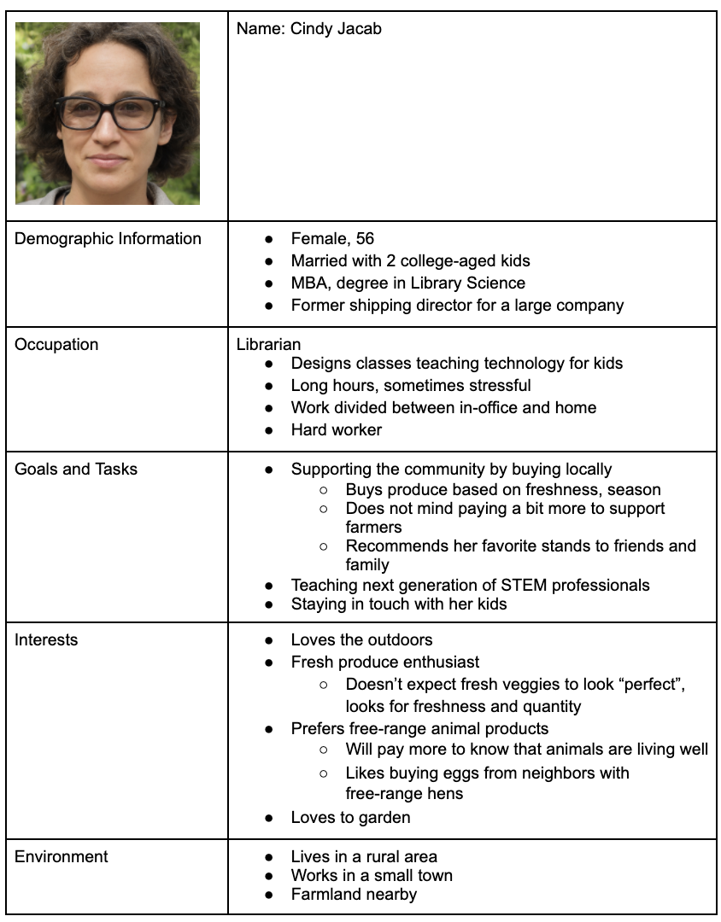
Revised Persona
Added details and information based on Participant 2

Slide 29
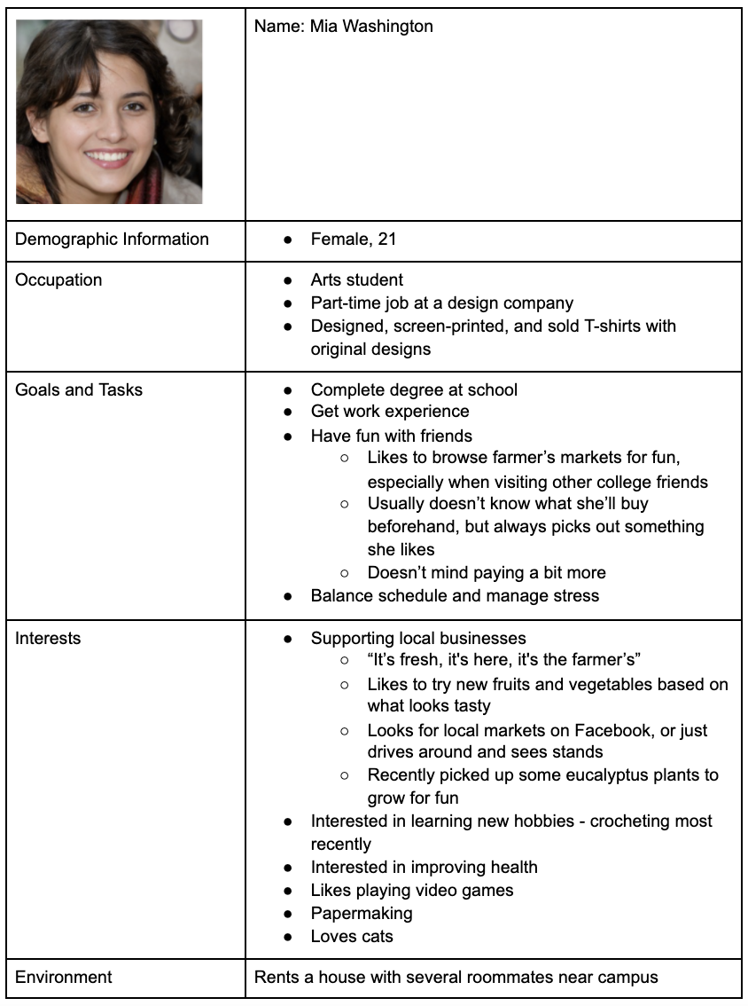
Revised Persona
Added details and information based on Participant 1

Slide 30
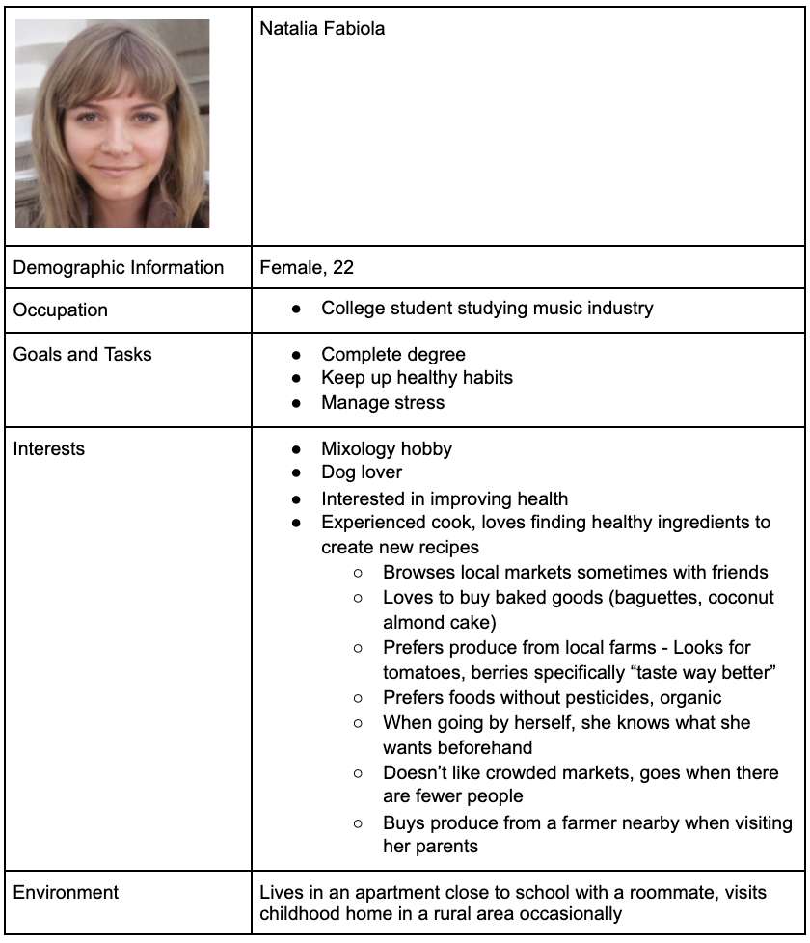
Revised Persona
Added details and information based on Participant 3

Slide 31
Week 05
Competitive Usability Evaluation (Benchmarks)
Roles and Goals
Primary Workflows Worksheet
2 Storyboards

Slide 32
Benchmarks Presentation
Presentation linked here

Slide 33
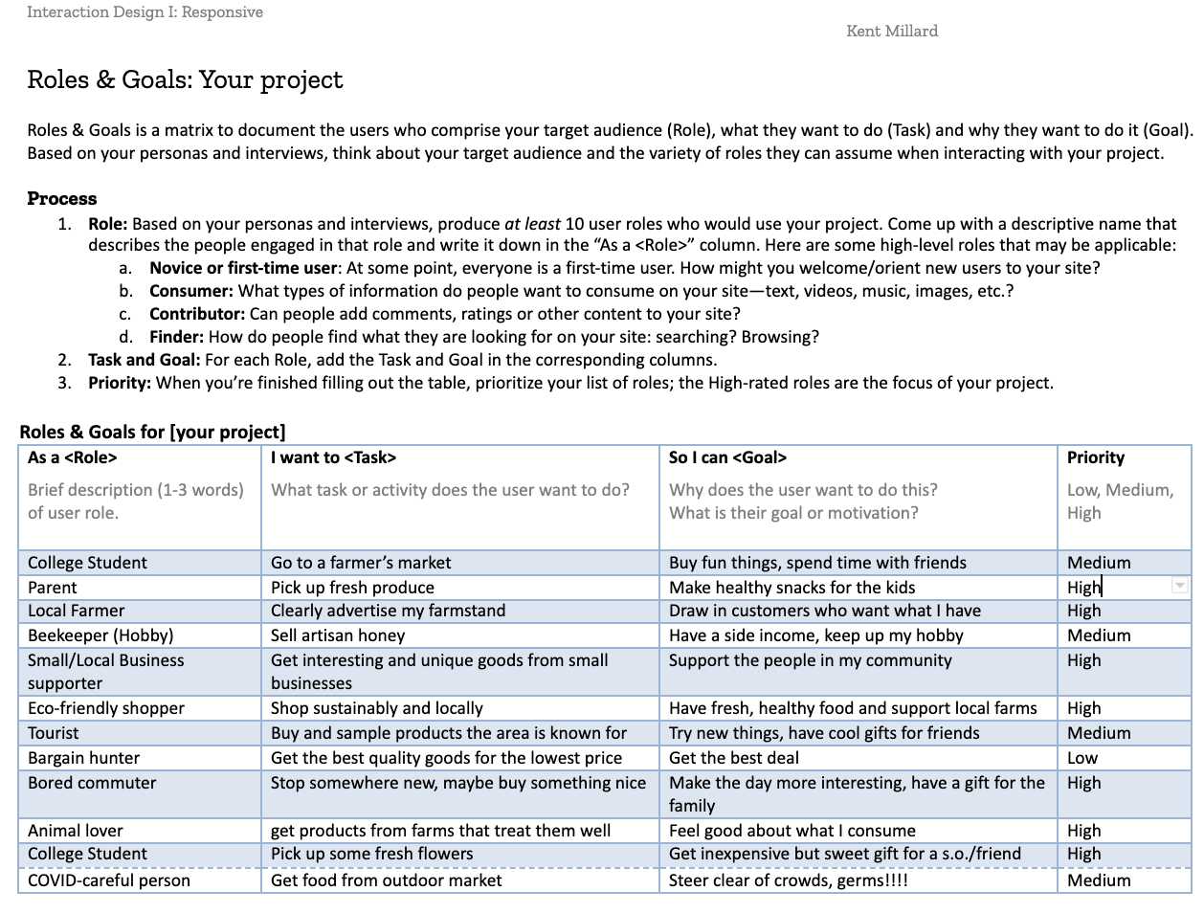
Roles & Goals

Slide 34
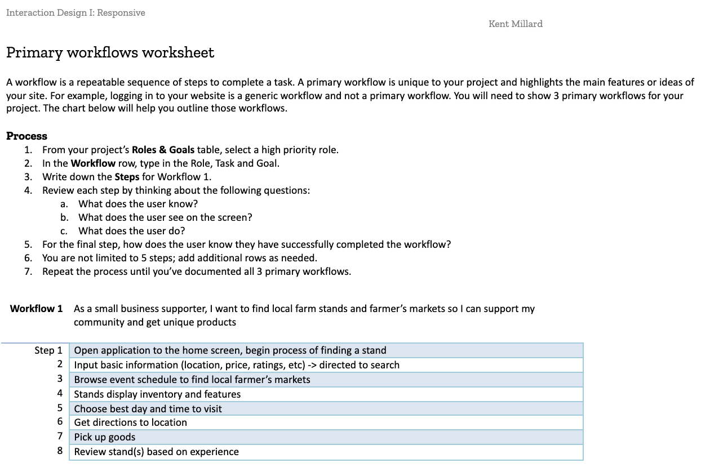
Primary Workflows-
first page

Slide 35
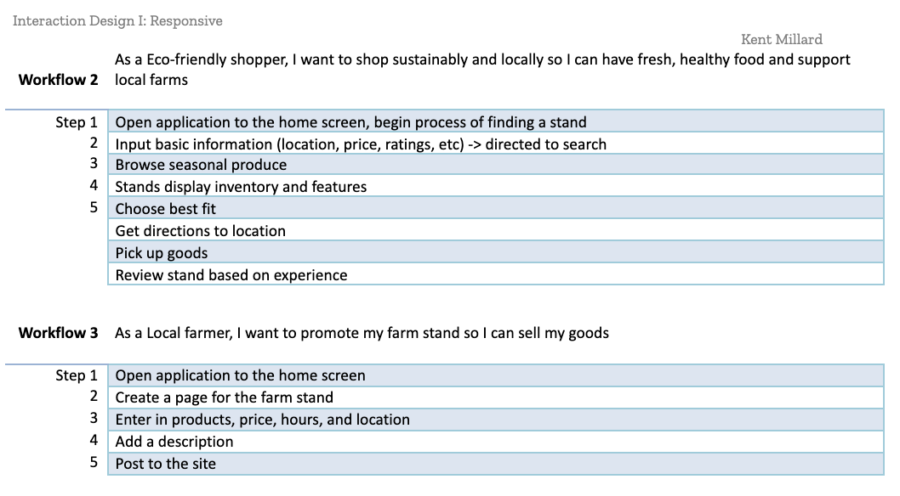
Primary Workflows-
second page

Slide 36
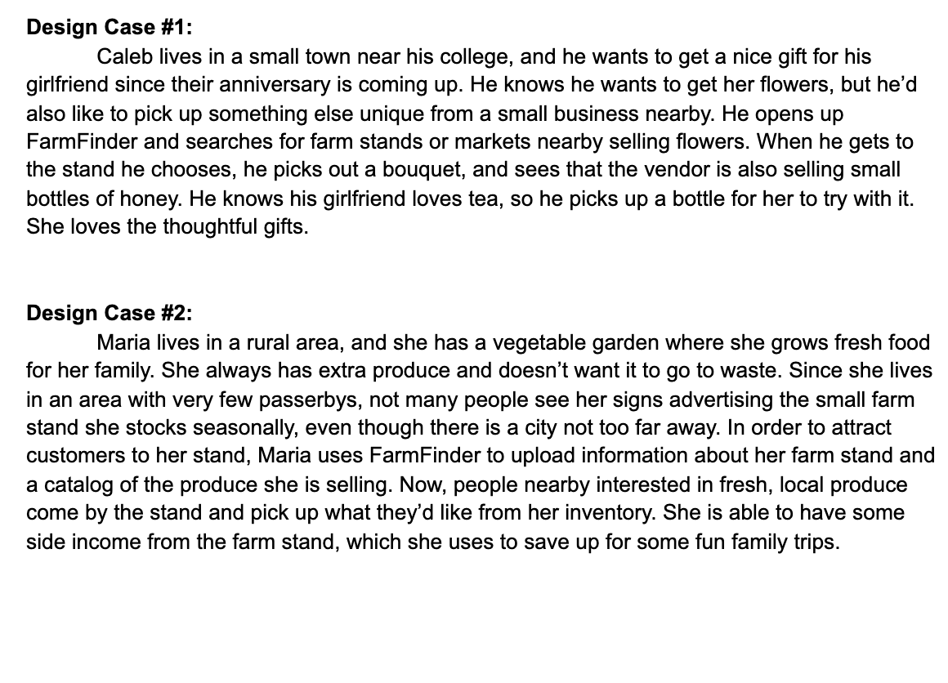
Storyboard Scenarios

Slide 37
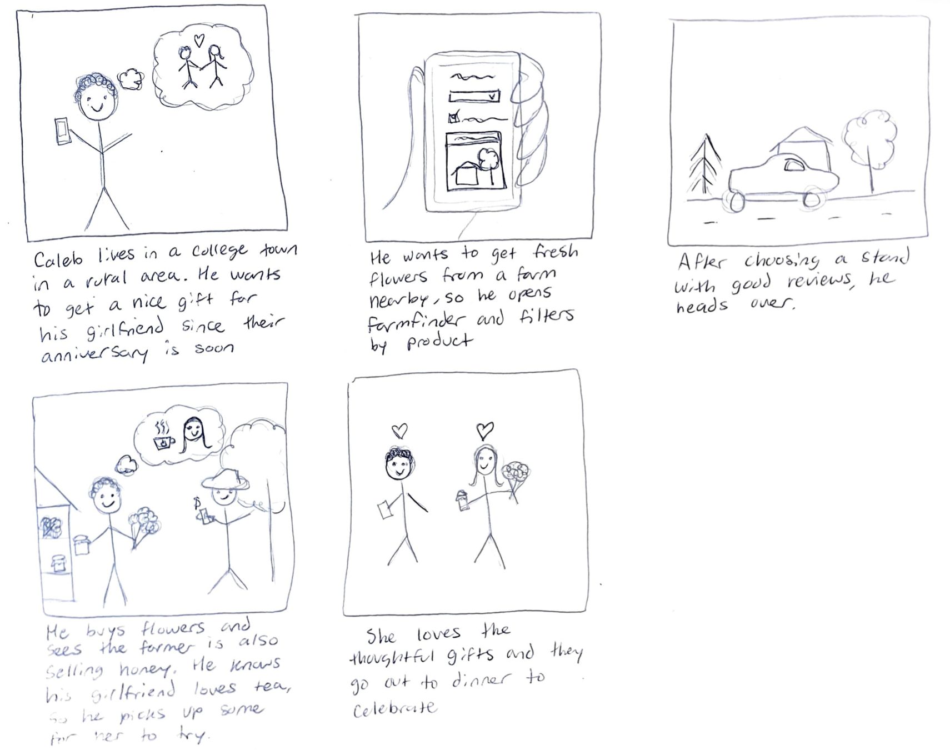
Design case #1

Slide 38
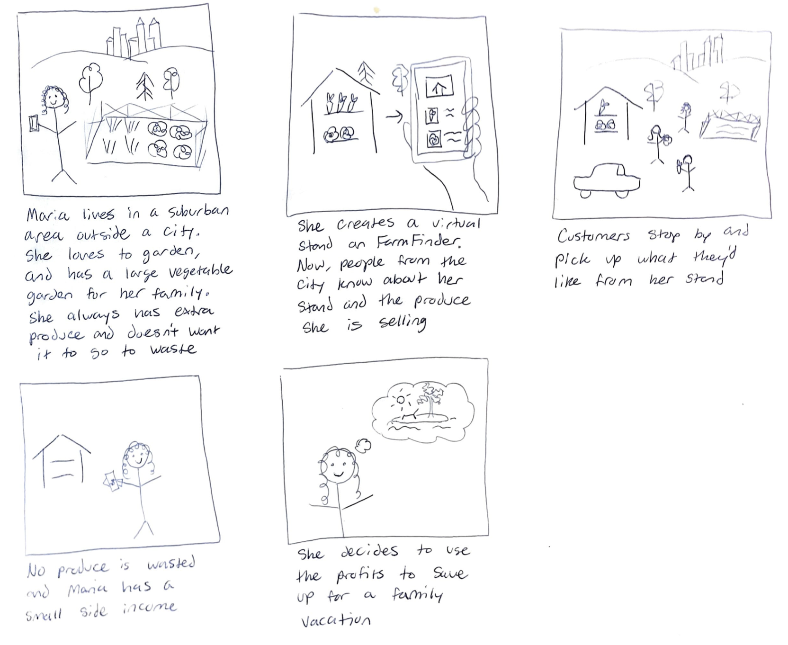
Design case #2

Slide 39
Week 06
UI Brain Drawings
Elevator Pitch
Site Map
Wireframes

Slide 40
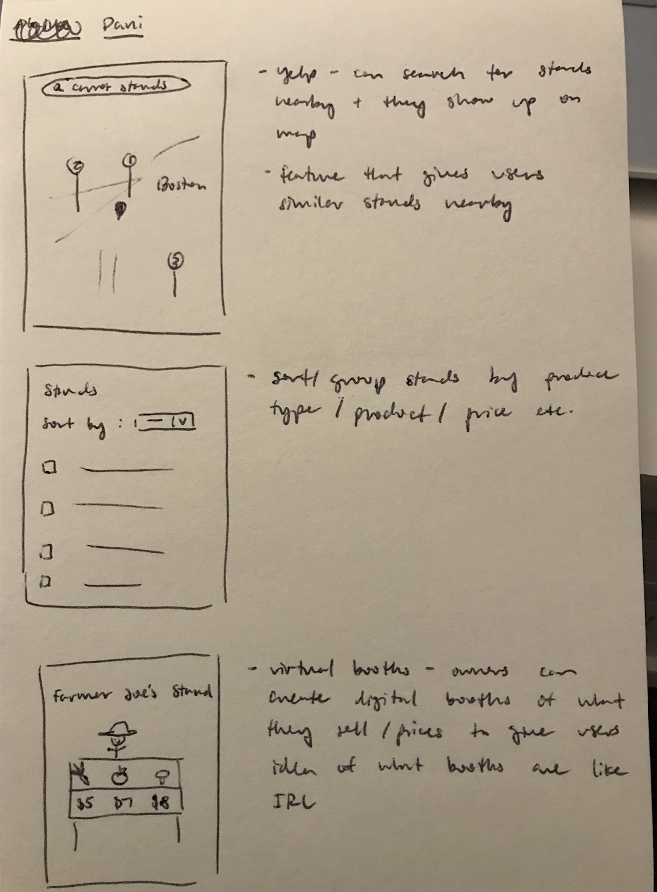
Brain Drawing #1 - Amy

Slide 41
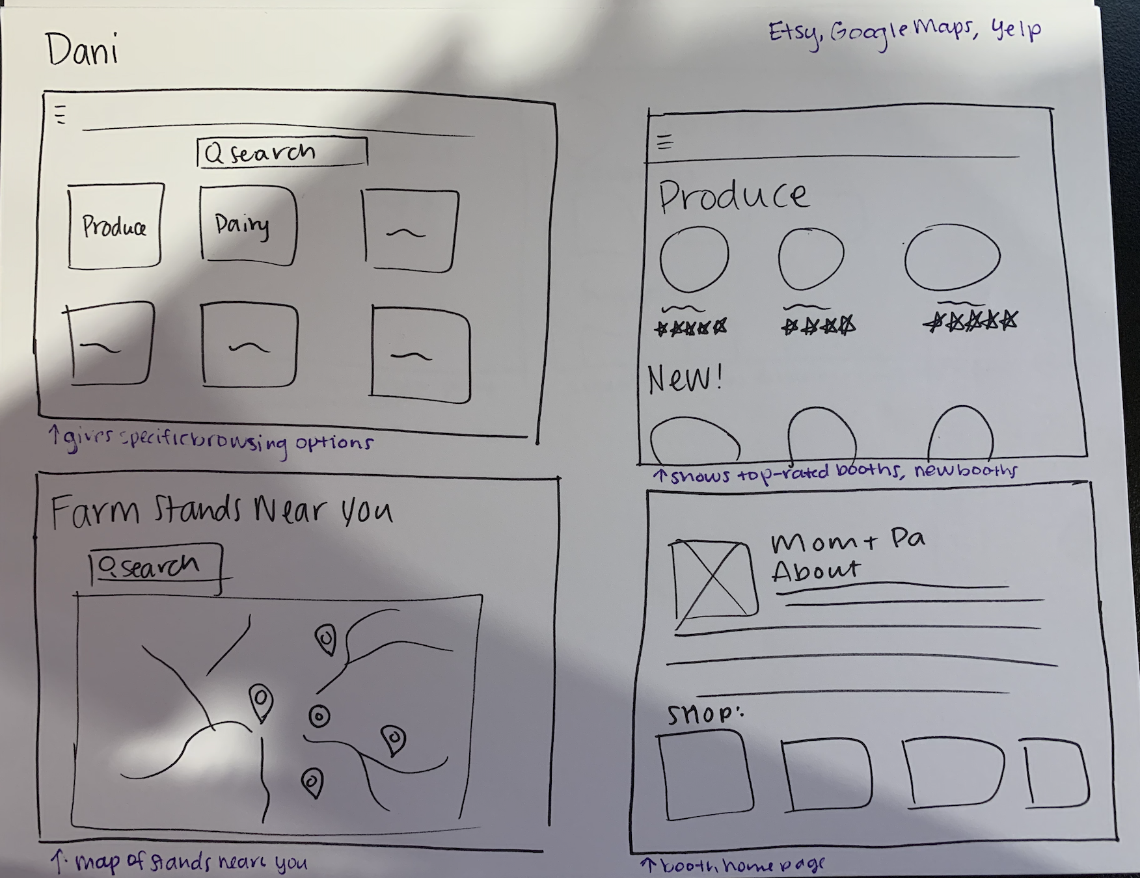
Brain Drawing #2 - Alaine

Slide 42
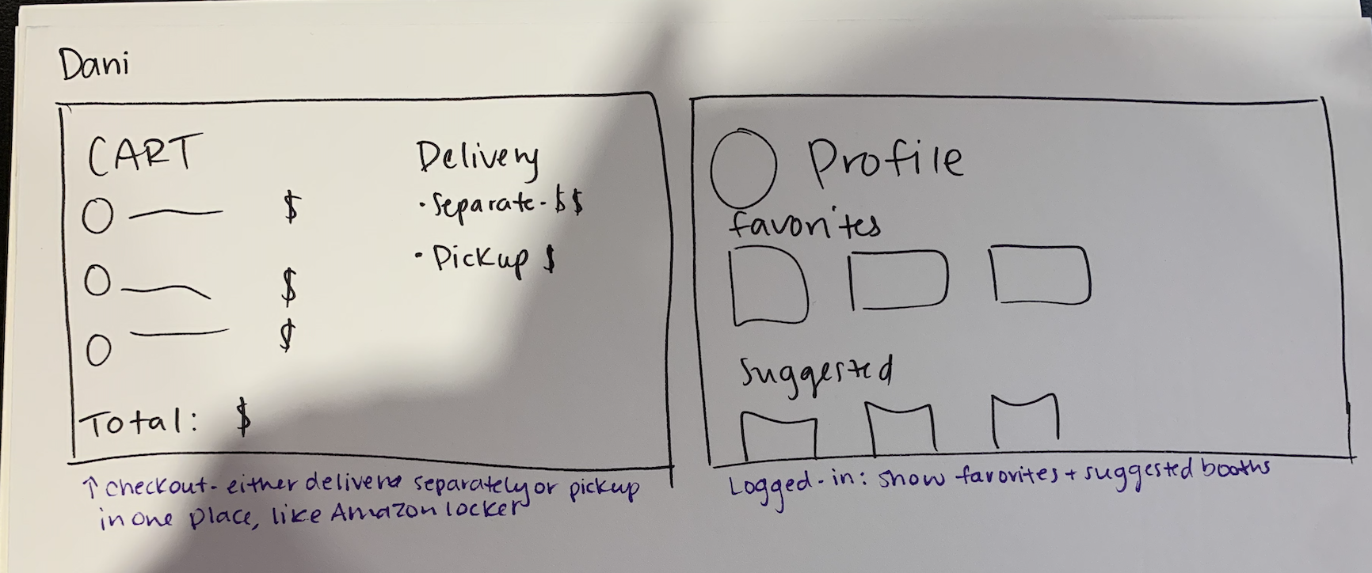
Brain Drawing #2 - Alaine

Slide 43
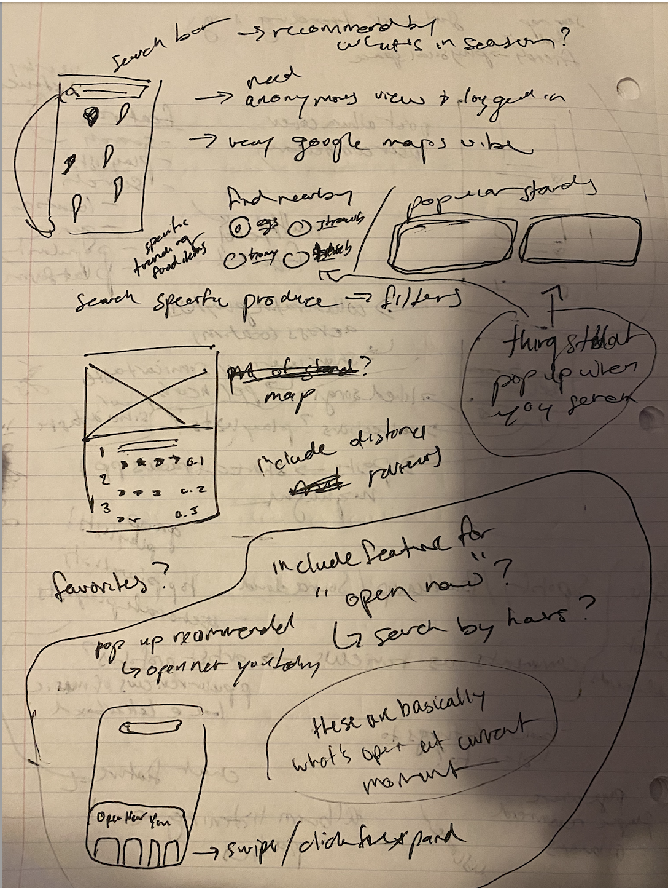
Brain Drawing #3 - Devin

Slide 44
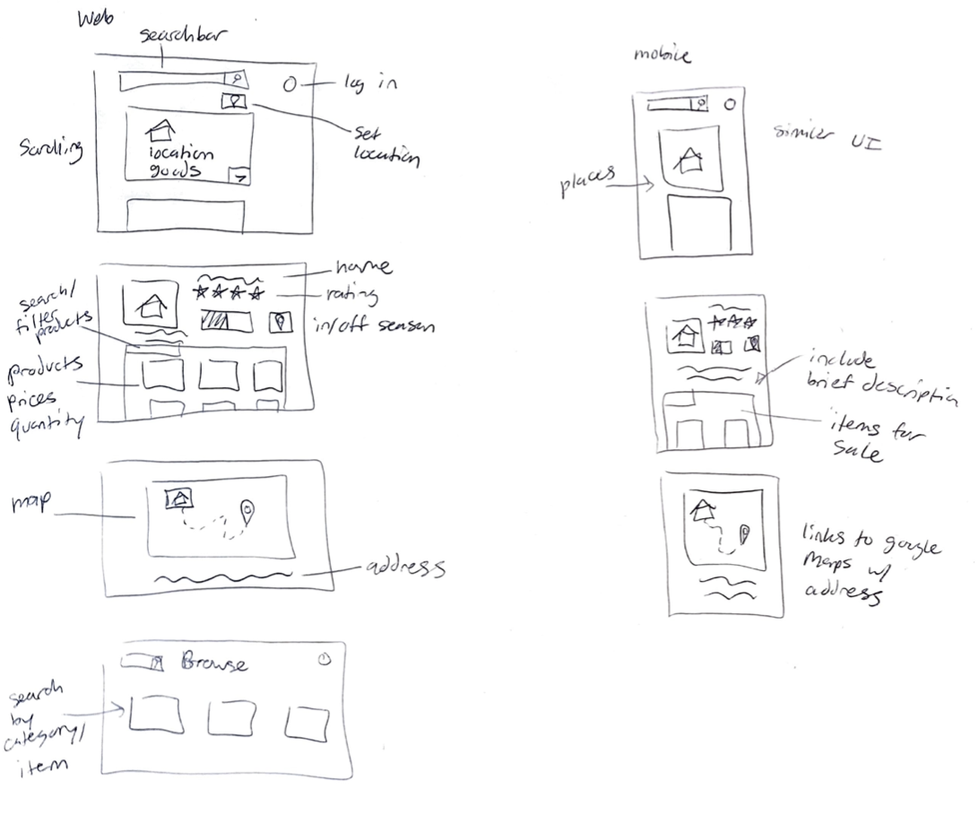
Brain Drawing #4 - my own
Came up with some concepts for a web and mobile design

Slide 45
Elevator Pitch
For people interested in shopping at local/eco-friendly businesses who are looking to get fresh produce and other goods, FarmFinder is a resource that is tailored towards finding products from small, local businesses rather than large companies. Unlike Facebook Marketplace, FarmFinder has a UI designed to find in-season, locally available produce and other goods.

Slide 46
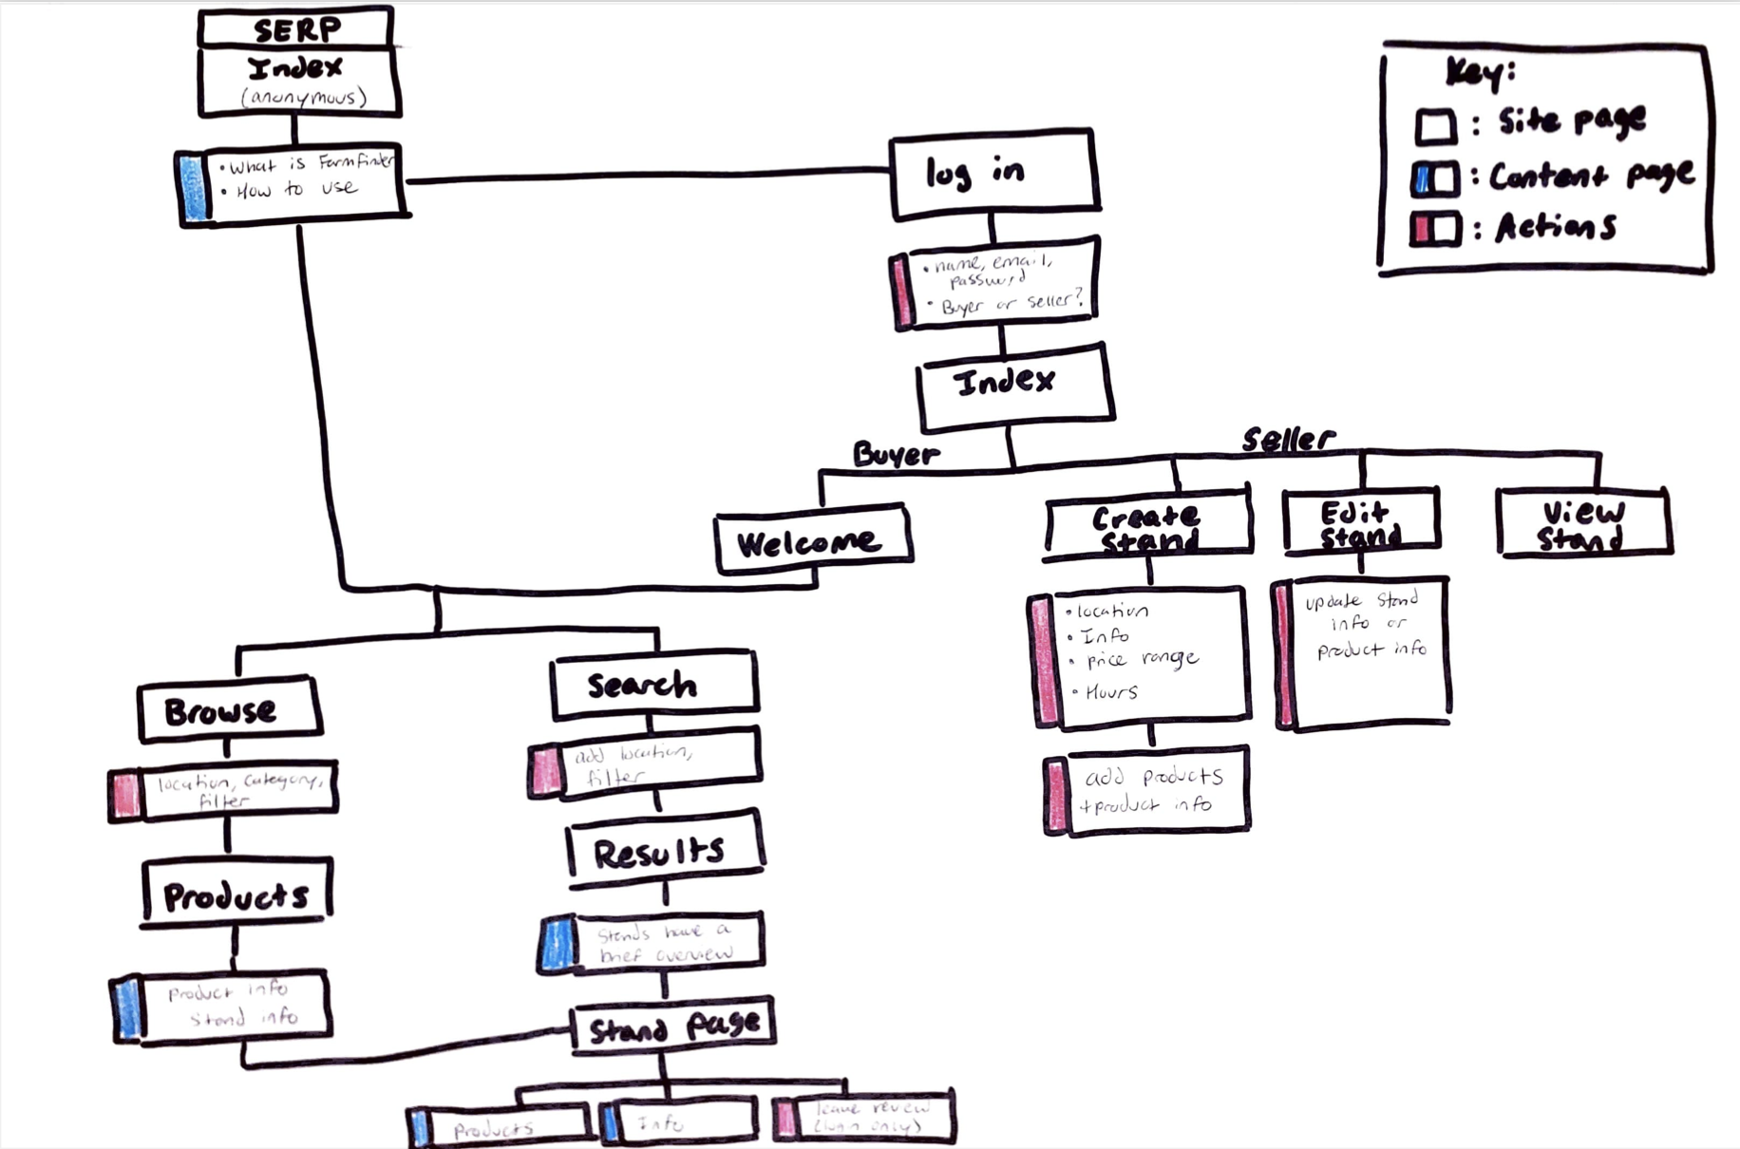

Slide 47
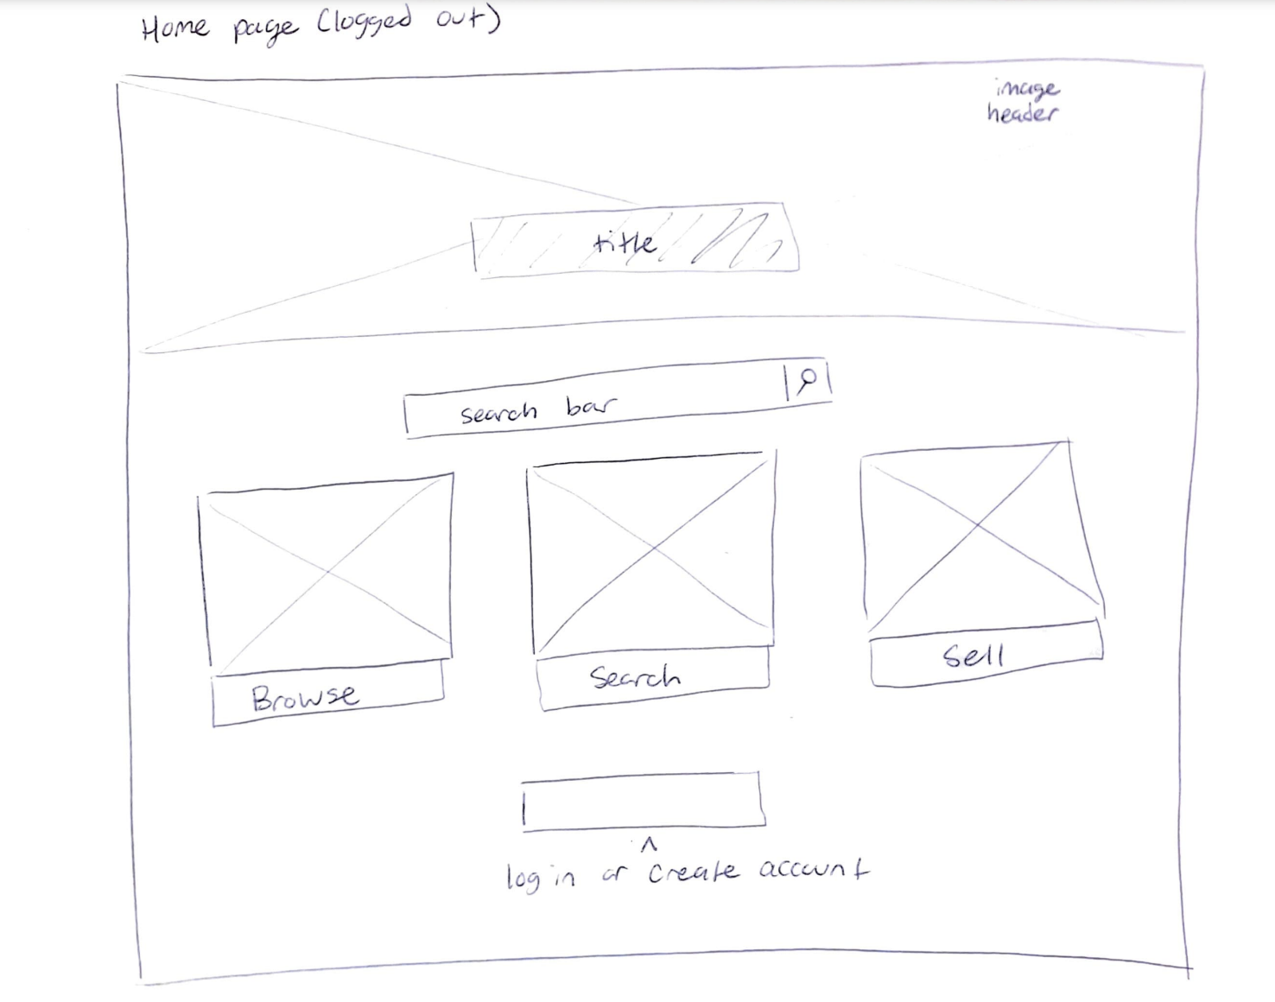
Wireframe
Page 1 - logged out home page

Slide 48
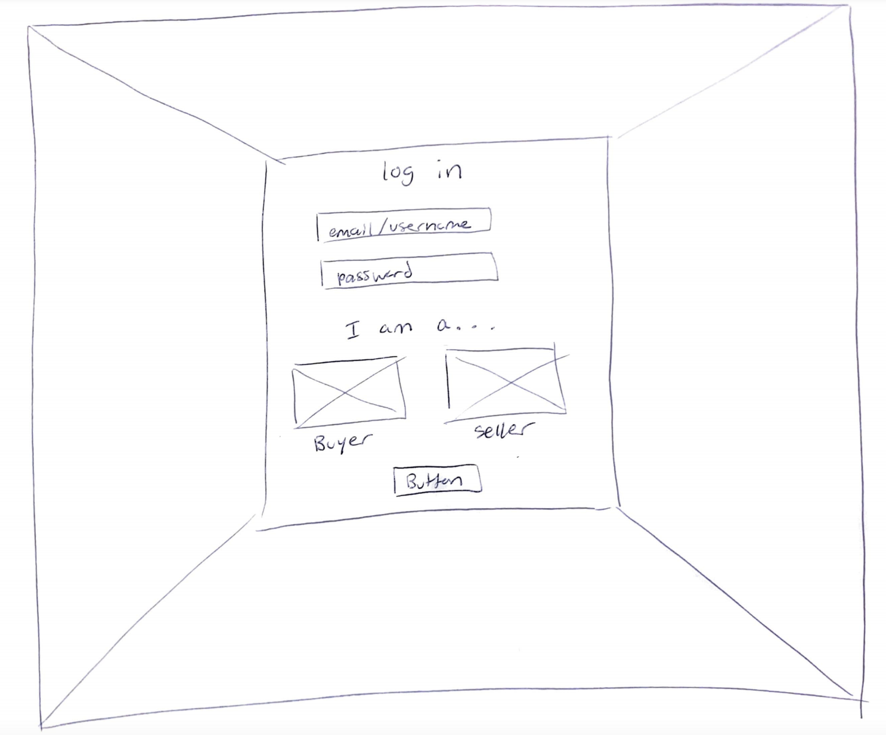
Wireframe
Page 2 - login page

Slide 49
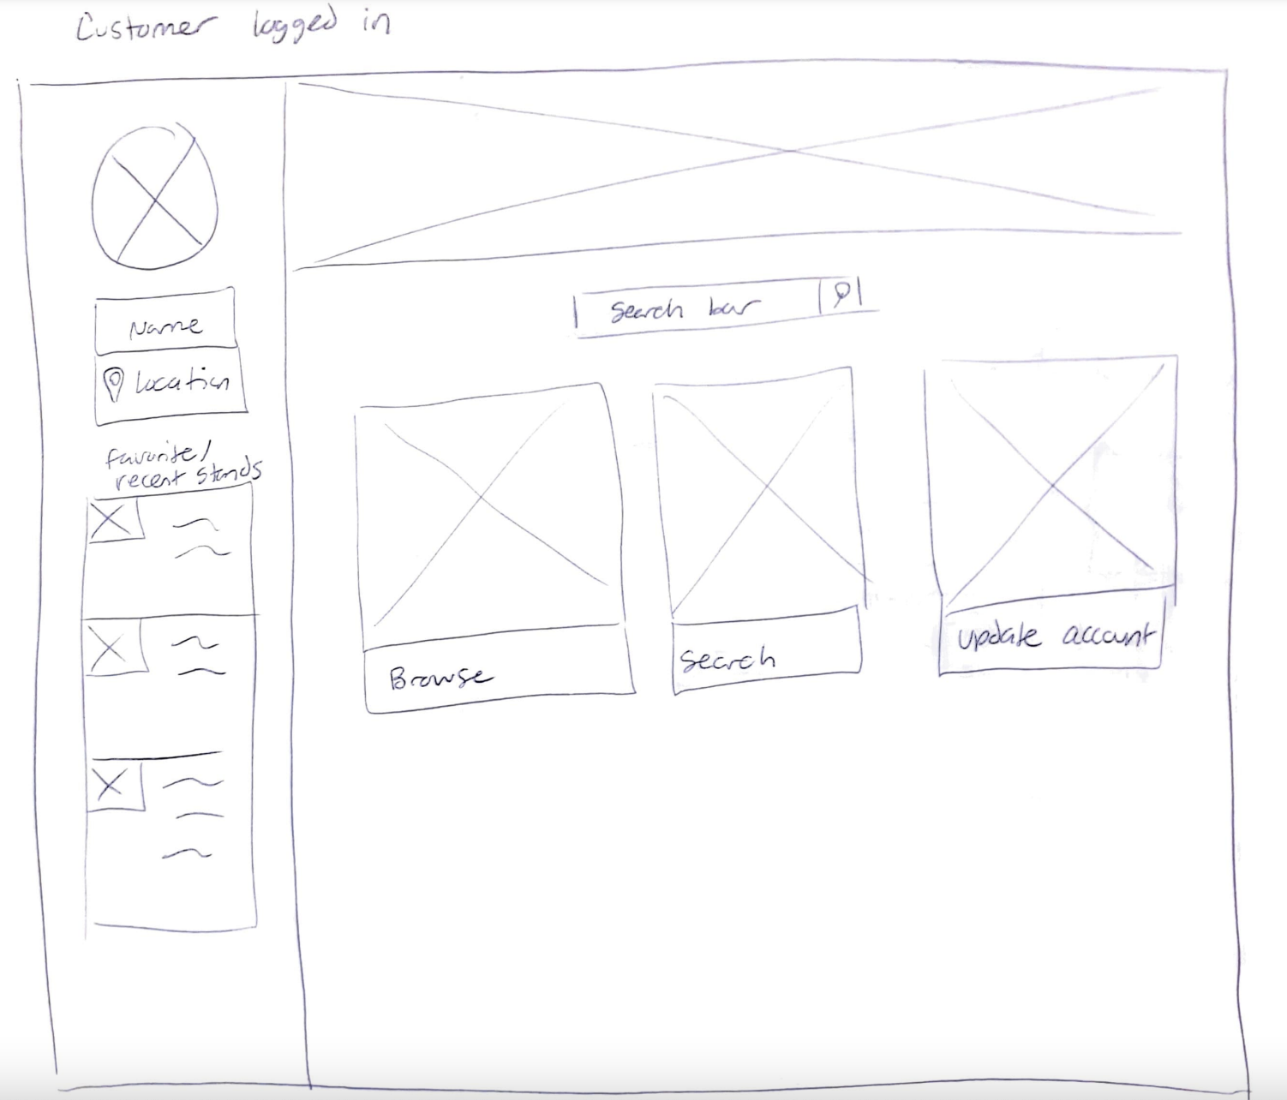
Wireframe
Page 3 - logged in customer homepage

Slide 50
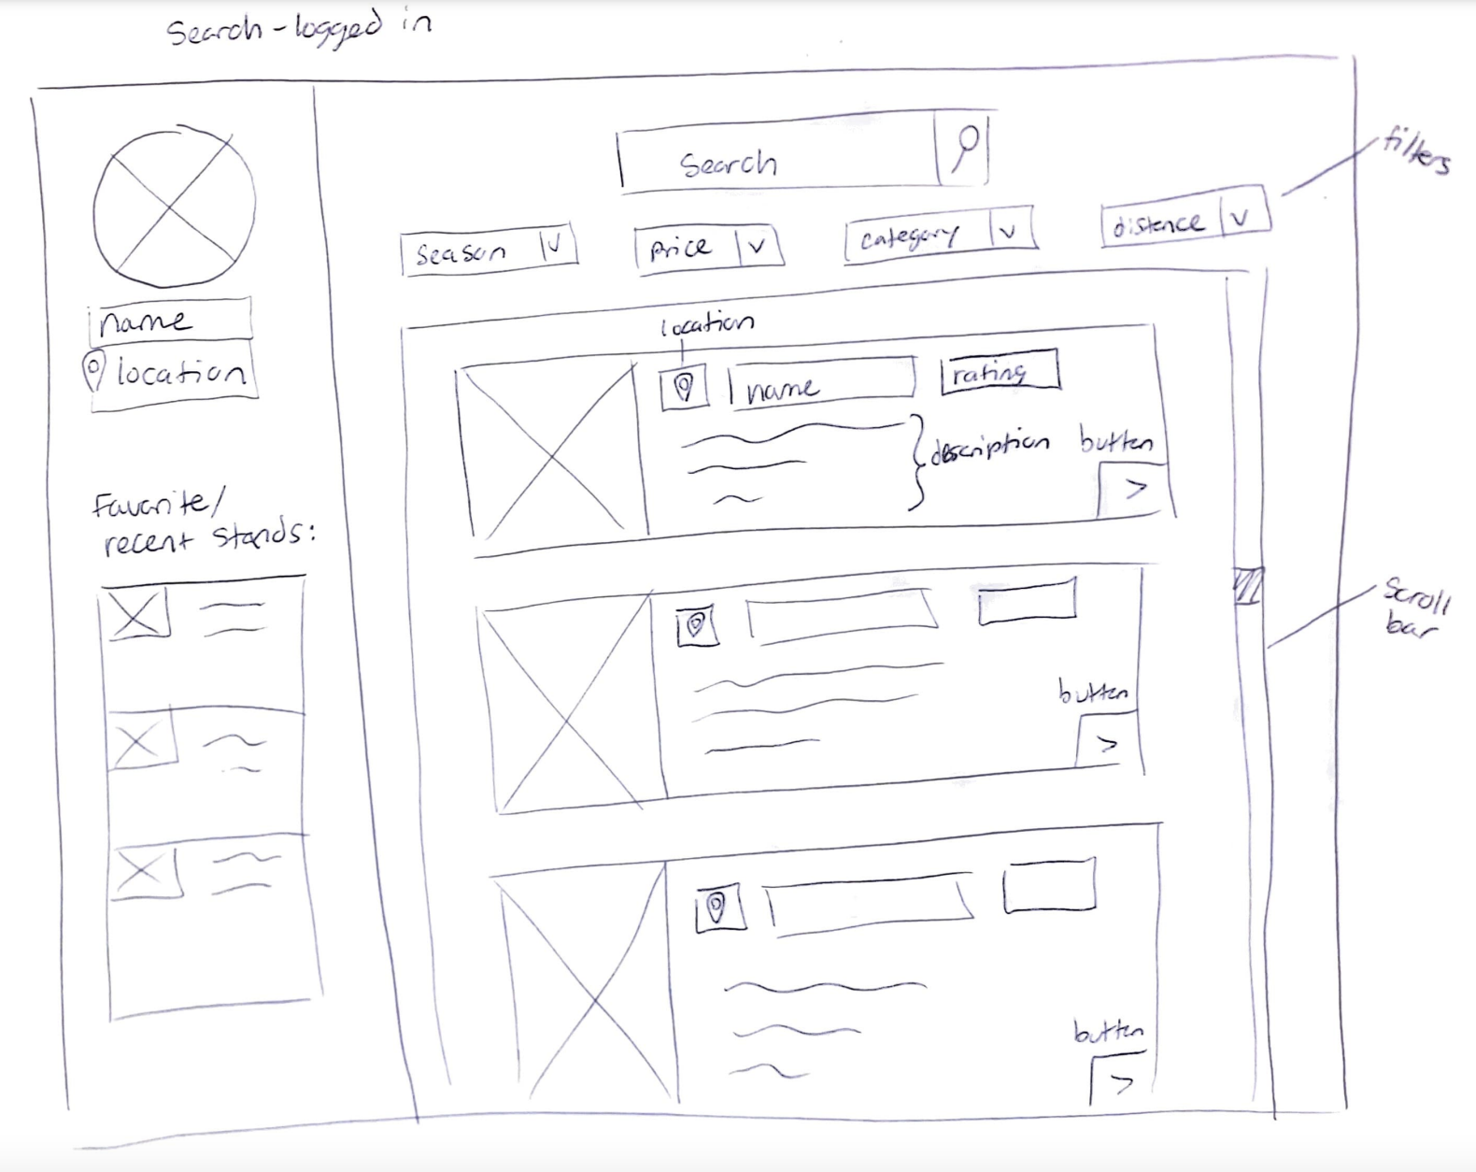
Wireframe
Page 4 - logged in customer search page

Slide 51
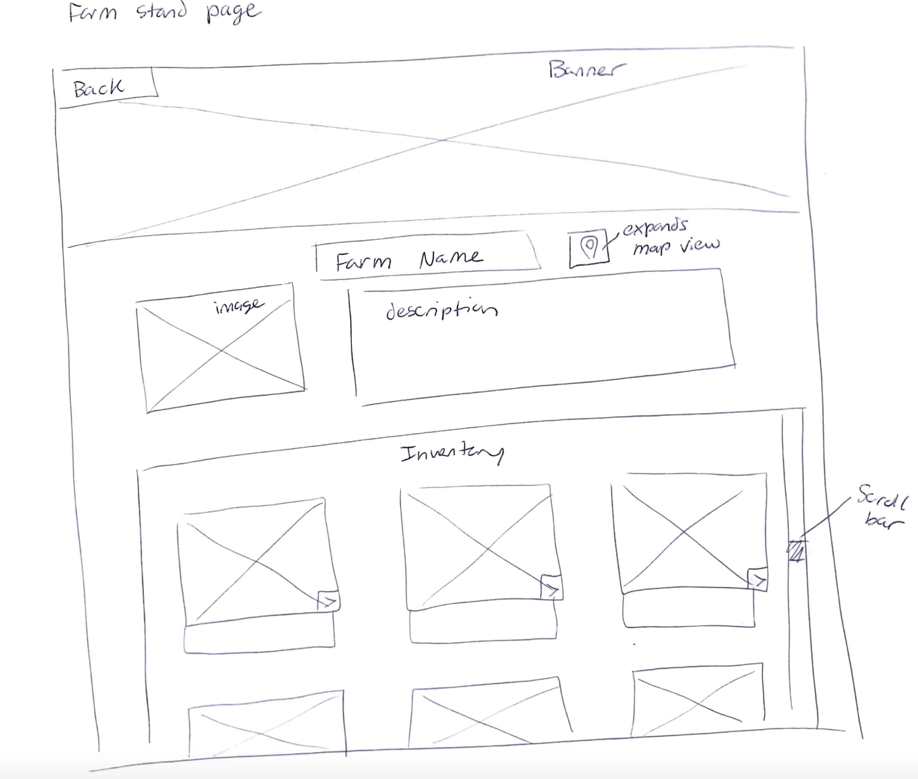
Wireframe
Page 5 - selected farm stand display page

Slide 52
Week 07
Sitemap (digital)
Clickable wireframes for 2 desktop workflows

Slide 53
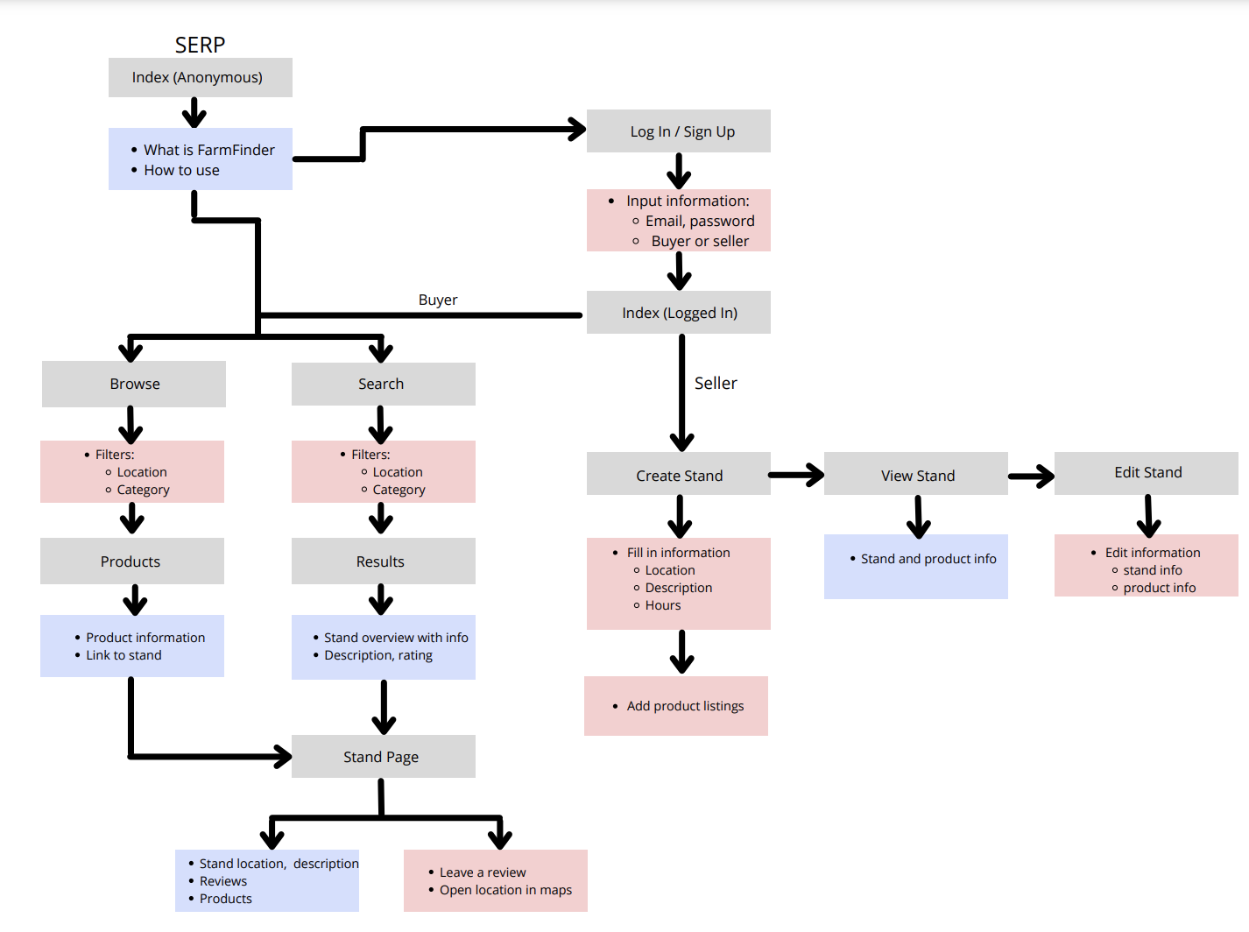
Key
Site page
Content page
Actions

Slide 54
Clickable Wireframe - Desktop
Workflow 1: Buyer creates an account, searches for goods near them

Slide 55
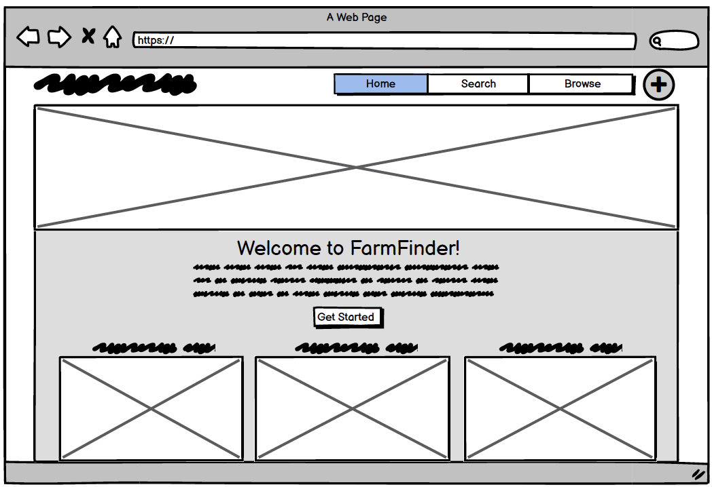

Slide 56
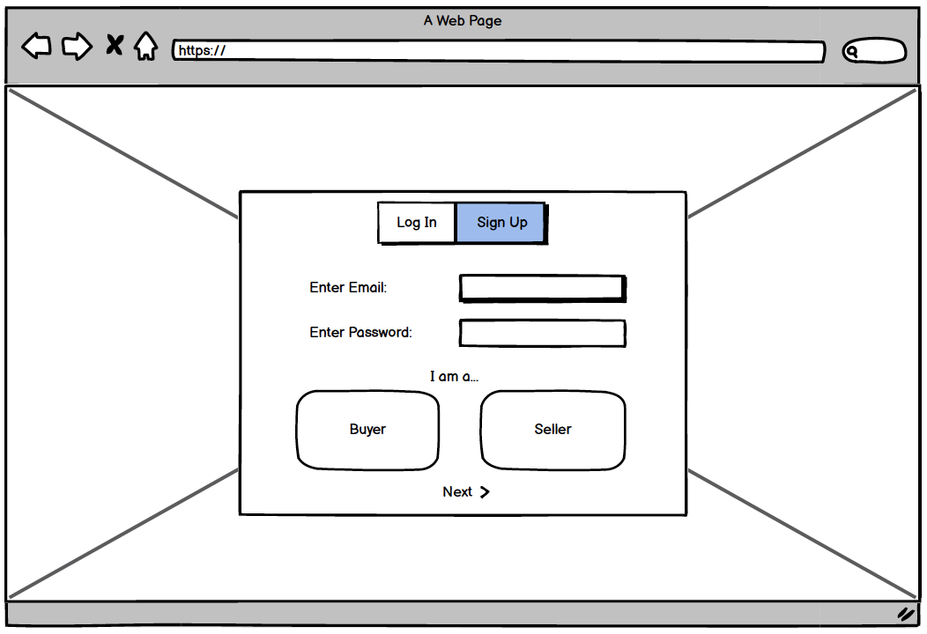

Slide 57
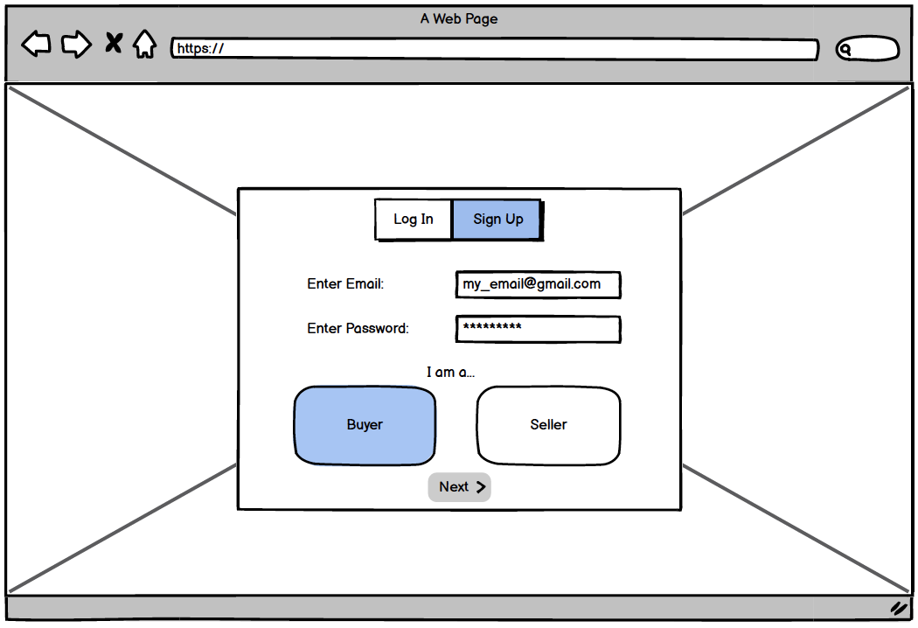

Slide 58


Slide 59
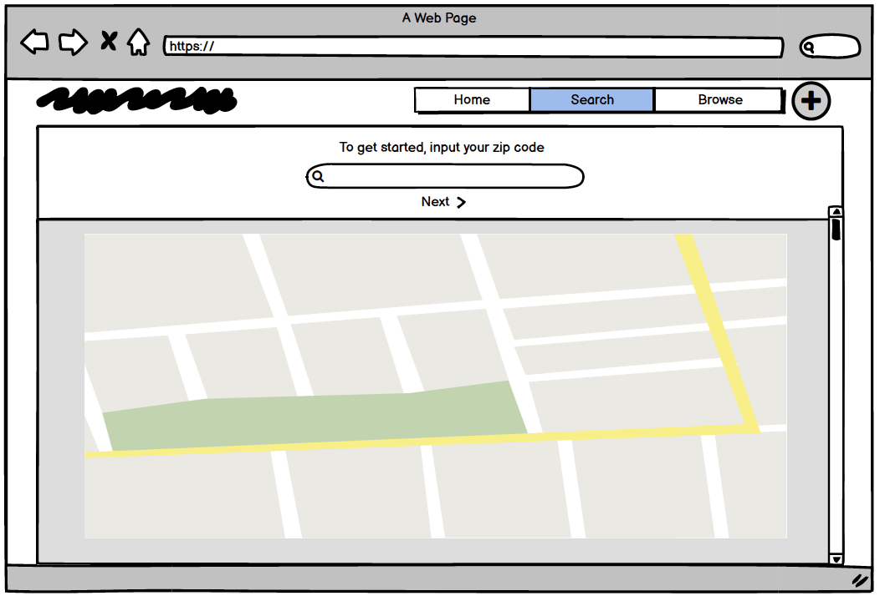

Slide 60
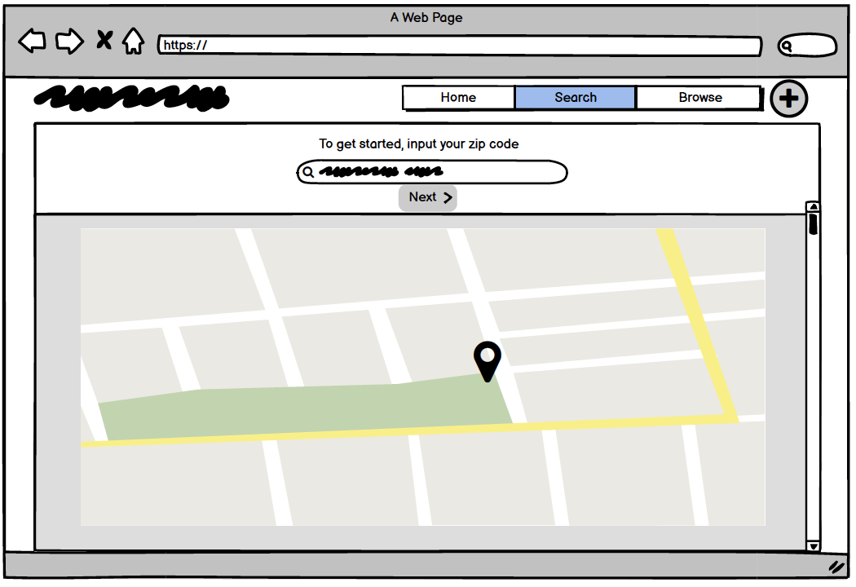

Slide 61
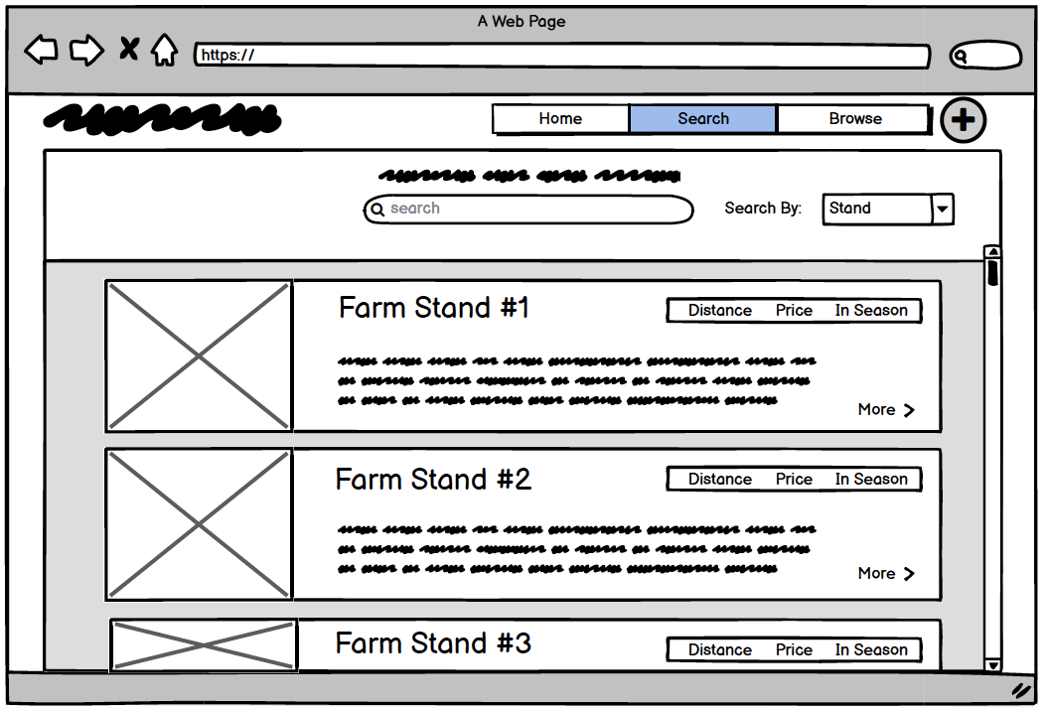

Slide 62
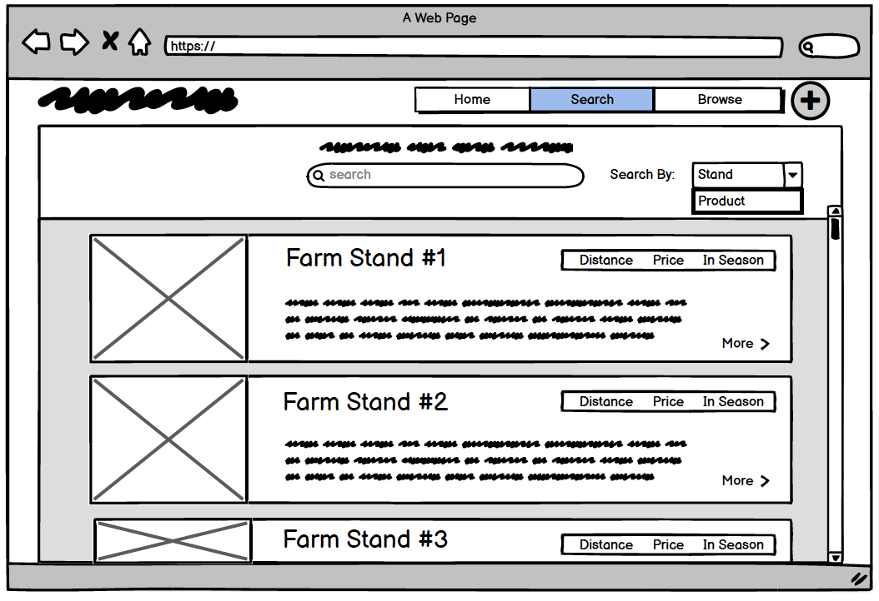

Slide 63
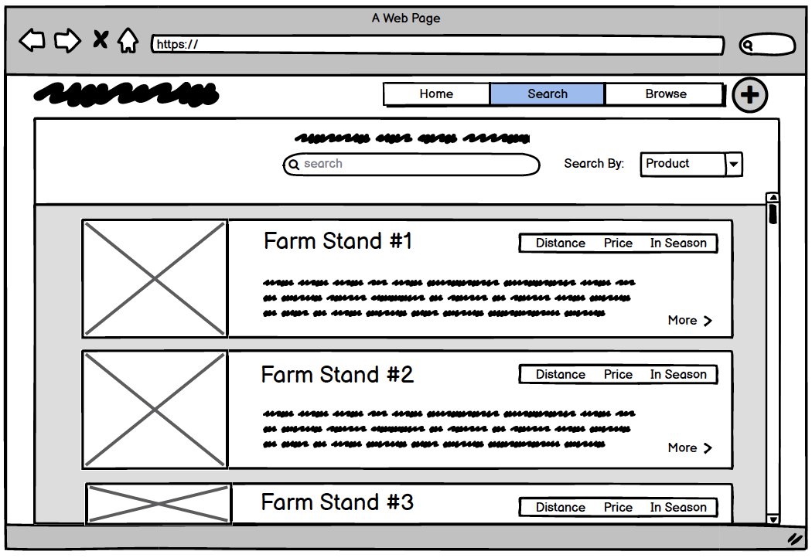

Slide 64
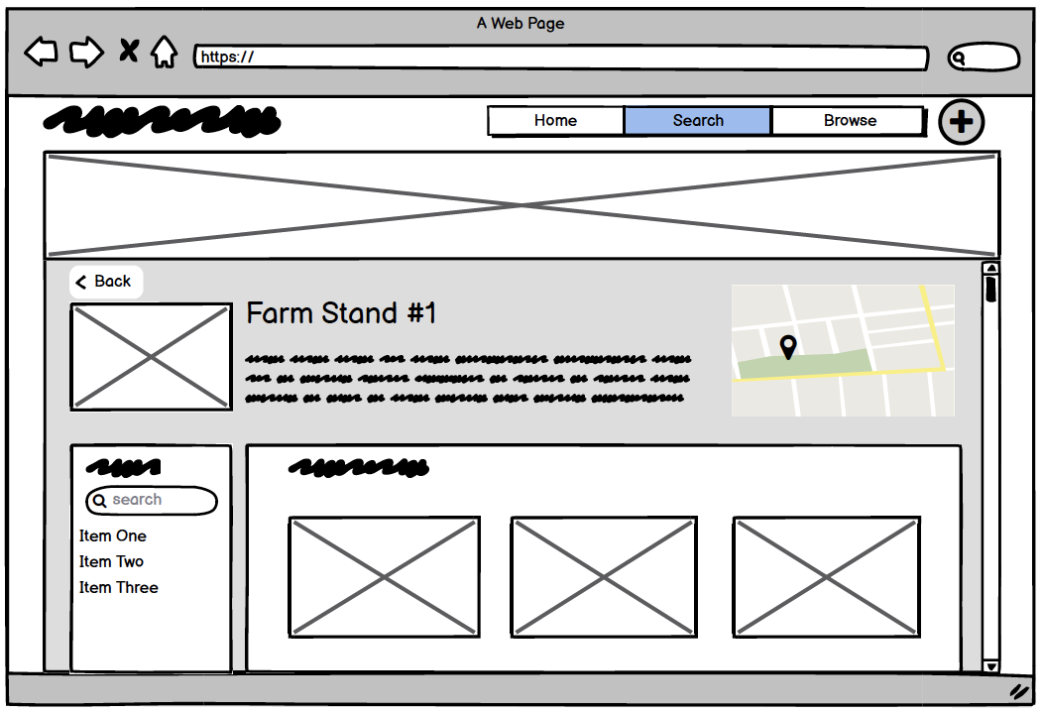

Slide 65
Clickable Wireframe - Desktop
Workflow 2: Seller creates an account, sets up their stand

Slide 66
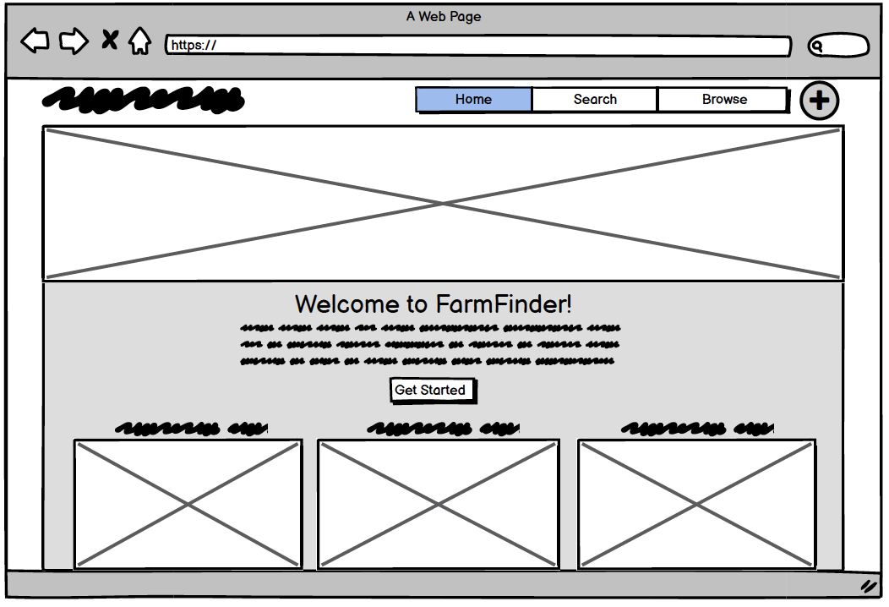

Slide 67


Slide 68
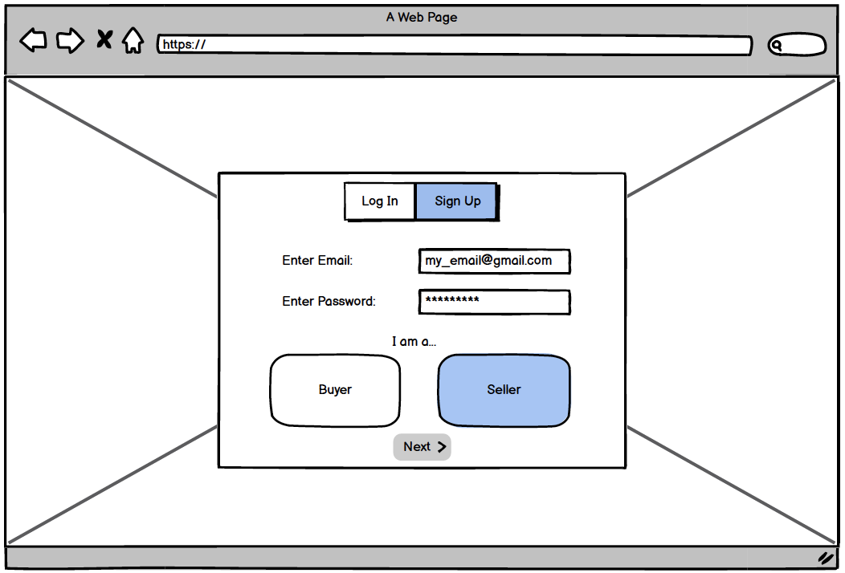

Slide 69
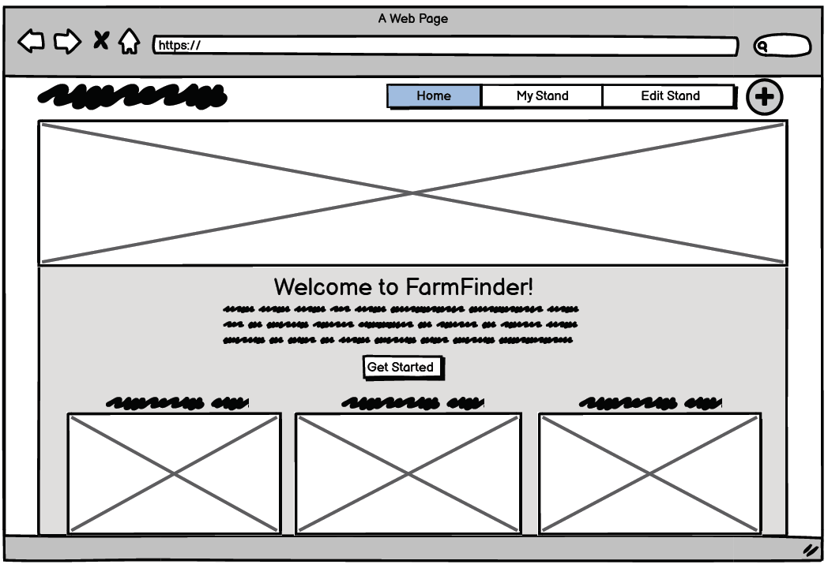

Slide 70
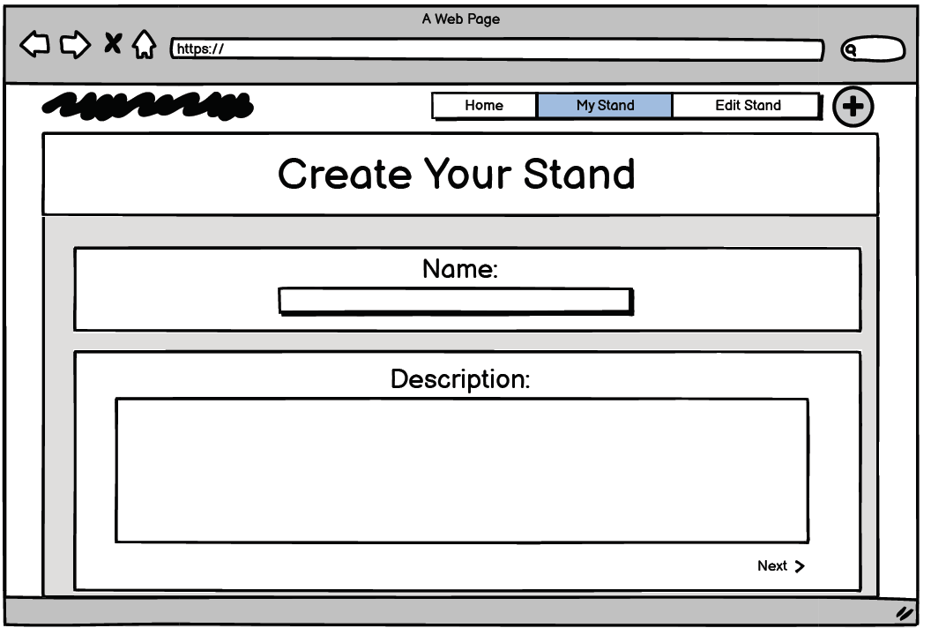

Slide 71
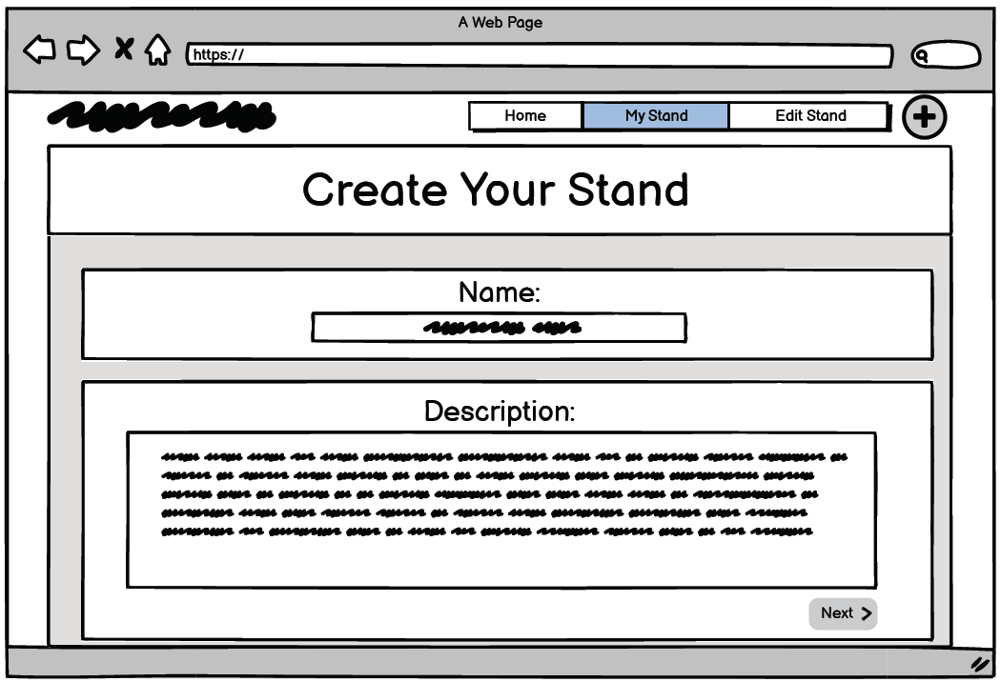

Slide 72
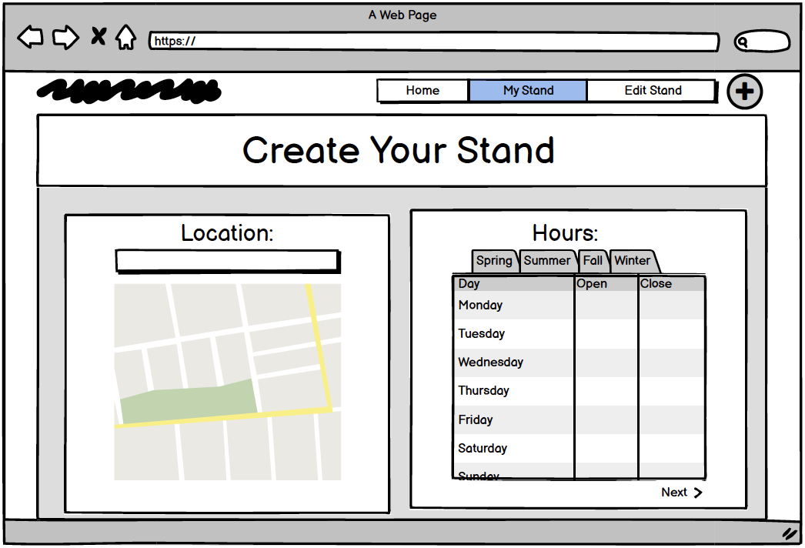

Slide 73
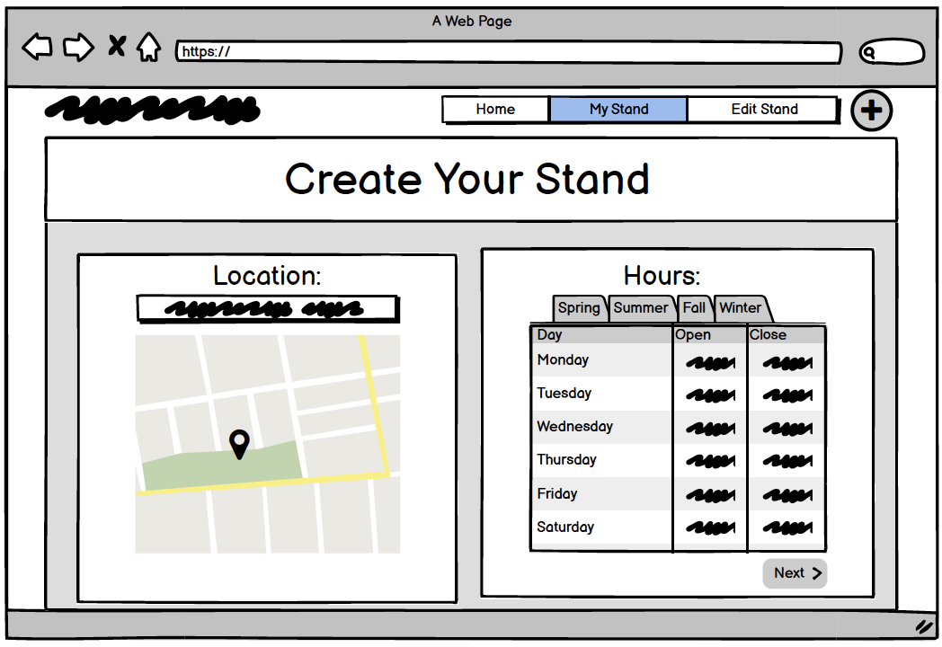

Slide 74


Slide 75
Week 08
Revised clickable wireframes for 2 desktop workflows
Clickable wireframes for 2 mobile workflows
Clickable wireframes for 1 desktop or mobile workflow
Usability test plan
Moderator script

Slide 76
Clickable Wireframe - Desktop (Revised)
Workflow 1: Buyer creates an account, searches for goods near them

Slide 85
Clickable Wireframe - Desktop (Revised)
Workflow 2: Seller creates an account, sets up their stand

Slide 95


Slide 96
Clickable Wireframe - Mobile
Workflow 1: Buyer creates an account, searches for goods near them

Slide 97




Slide 98




Slide 99



Slide 100
Clickable Wireframe - Mobile
Workflow 2: Seller creates an account, sets up their stand

Slide 101




Slide 102




Slide 103




Slide 104



Slide 105
Clickable Wireframe - Desktop
Workflow 3: Seller adds inventory (a sellable item) to their stand

Slide 106


Slide 107


Slide 108


Slide 109


Slide 110


Slide 111


Slide 112


Slide 113


Slide 114


Slide 115


Slide 116


Slide 117


Slide 118


Slide 119
Week 09
Usability Test Findings
Revised wireframes based on testing

Slide 120
Usability Test Findings
Presentation linked here

Slide 121
Revised Wireframes - Desktop
Workflow 1: Buyer creates an account, searches for goods near them

Slide 122


Slide 123


Slide 124


Slide 125


Slide 126


Slide 127


Slide 128


Slide 129
Revised Wireframes - Desktop
Workflow 2: Seller creates an account, sets up their stand

Slide 130


Slide 131


Slide 132


Slide 133


Slide 134


Slide 135


Slide 136


Slide 137


Slide 138


Slide 139
Revised Wireframes - Desktop
Workflow 3: Seller adds inventory (a sellable item) to their stand

Slide 140


Slide 141


Slide 142


Slide 143


Slide 144


Slide 145


Slide 146
Revised Wireframes - Mobile
Workflow 1: Buyer creates an account, searches for goods near them

Slide 147




Slide 148




Slide 149


Slide 150
Revised Wireframes - Mobile
Workflow 2: Seller creates an account, sets up their stand

Slide 151




Slide 152




Slide 153




Slide 154



Slide 155
Week 10
Crazy 8s identity mark drawings
3 distinctly different home screen designs (desktop)
10 type hierarchy studies using 3 typefaces

Slide 156

Crazy 8s:
Hsiao-Tung (Chrissy) Chen

Slide 157

Crazy 8s:
Alaine Bennett

Slide 158

Crazy 8s:
Amy Dang

Slide 159


Slide 160


Slide 161


Slide 162


Slide 163


Slide 164


Slide 165


Slide 166


Slide 167


Slide 168


Slide 169


Slide 170


Slide 171


Slide 172
Week 11
2 desktop home screens (anonymous + logged in)
2 mobile home screens (anonymous + logged in)
15 identity mark roughs (hand-drawn)
10 type studies for identity mark

Slide 173


Slide 174


Slide 175


Mobile Home Screen-
Anonymous
Mobile Home Screen-
Logged In

Slide 176

Identity Mark roughs

Slide 177

Type Logo Studies:
Rockwell
Tahoma
PT Sans

Slide 178
Week 12
Identity mark comp

Slide 179

Final Logo:
Rockwell font, regular

Slide 180
All UI screens for desktop and mobile

Slide 181

Desktop
Workflow 1: Buyer creates an account, searches for goods near them

Slide 182


Slide 183


Slide 184


Slide 185


Slide 186


Slide 187


Slide 188


Slide 189


Mobile
Workflow 1: Buyer creates an account, searches for goods near them

Slide 190




Slide 191




Slide 192



Slide 193

Desktop
Workflow 2: Seller creates an account, sets up their stand

Slide 194


Slide 195


Slide 196


Slide 197


Slide 198


Slide 199


Slide 200

Mobile
Workflow 2: Seller creates an account, sets up their standc

Slide 201




Slide 202




Slide 203
Desktop
Workflow 3: Seller adds inventory (a sellable item) to their stand
Images begin on the next slide

Slide 204


Slide 205


Slide 206


Slide 207

Mobile
Workflow 3: Seller adds inventory (a sellable item) to their stand

Slide 208




